Slide 1
Overpayments
Effective Practices
Kate Kingree, Program Manager, Employment Resources Inc.
August 7, 2014
Notes:
Overpayment

Slide 2
Why do Overpayments Matter?

Slide 3
It Affects your EN’s Payments
Underpaid
Overpaid

Slide 4
When and how Overpayments occur?
SSDI
SSI
VS

Slide 5
SSDI: How Overpayments Happen

Slide 6
Work Reviews

Slide 7
Wage Reporting

Slide 8
Misunderstanding of work incentives
?
?
?
?
?
?
?
?
TWP
SGA
VS

Slide 9
System Problems/Inefficiencies

Slide 10
SSI: How Overpayments Happen

Slide 11
Wage Reporting

Slide 12
Misunderstanding of work

Slide 13
System Problems/Inefficiencies
Don’t work together

Slide 14
Eligibility Requirements

Slide 15
What do we do when they occur?

Slide 16
Determine if the information is accurate

Slide 17
Is the consumer using work incentives?

Slide 18
Does the IRS earnings record accurately reflect their earning history?

Slide 19
If the overpayment truly exists…

Slide 20
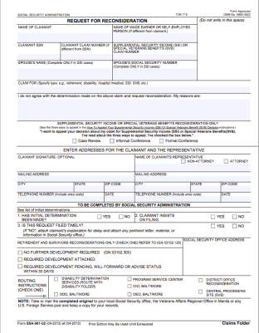
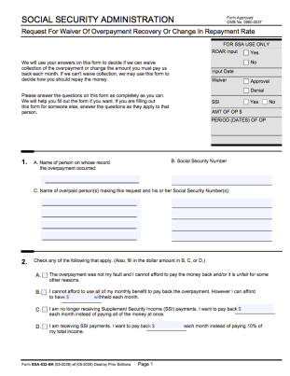
Forms to file
SSA Form 561- Request for Reconsideration
SSA Form 632- Request for Waiver or Change in Repayment Rate

Slide 21
Prevention Steps
Notes:
Prevention Steps General Information

Slide 22
Work with a Benefits Specialist

Slide 23
Reporting

Slide 24
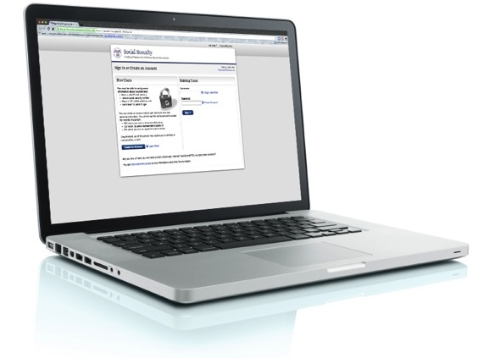
My SSA- check regularly

Slide 25
SSI Overpayment Prevention
Notes:
SSI Overpayment Prevention

Slide 26
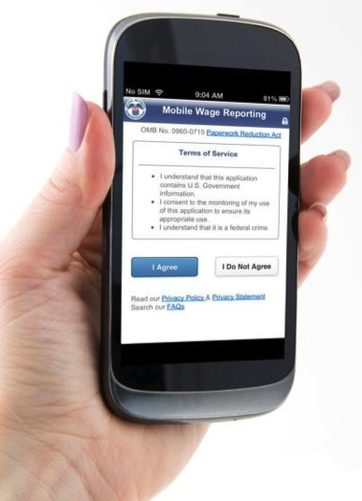
Mobile Wage Reporting App

Slide 27
Earnings Estimates

Slide 28
SSDI Overpayment Prevention

Slide 29
All or Nothing

Slide 30
Be one step ahead of the system

Slide 31
Request the initiation of a work review the last month of the Trial Work Period

Slide 32
Regularly visit MY SSA to check status of payments

Slide 33
Questions?

