Slide 1
VREN Quarterly Conference Call
State Vocational Rehabilitation Agency Employment Networks (VRENs)
Ticket to Work program Operations Support Manager

Slide 2
Welcome and Roll Call
FL State VR agency
GA State VR agency
IL State VR agency
MA State VR agency
MS State VR agency
NH State VR agency
OR State VR agency
SD State VR agency
VT State VR agency
VA State VR agency
SC State VR agency
KY State VR agency
IN State VR agency
OR Blind State VR agency
Notes:
Welcome to the quarterly call for VRENs. Today we will focus on ePay information with a quick review of the eTicket assignment interactive module.
We want to thank SSA for joining us today and they will remain with us throughout the session and will be available for questions throughout the presentation. This is not an operated assisted call so please mute your line. If you have to place us on hold, please hang up and call back.
[now, do roll call]

Slide 3
Agenda
Update on ePay process
Practice module and Quick Guide Use
Open discussion

Slide 4
ePay Update
Notes:
[Michelle’s welcome]

Slide 5
ePay Files
Quarterly VREN ePay files created the first month of the calendar quarter
January 20th
April 20th
July 20th
October 20th

Slide 6
Payment Files
Match between Tickets assigned and earnings posted
Office of Child Support and Enforcement earnings files
If no earnings are posted at TWL or above, SSN not included in the Payment Status Report.
Notes:
Payment files will be created based on matches of tickets assigned to VRENs to earnings posted to quarterly Office of Child Support and Enforcement earnings files. If no earnings are posted at Trial Work level or above, the social security numbers will not be included on the Payment Status Report.

Slide 7
Payment Criteria
Claims paid based on the model selected
Ongoing Support VRENs - All Available payments will be processed (e.g., Phase 1, Phase 2 and Outcome payments.
Phase 1 Milestone Only VRENs - Phase 1 Milestone payments for beneficiaries if no payments ever processed or the only payments processed are Phase 1 milestone payments.
Exclusion: pipeline cases – received Phase 2 and/or Outcome payments prior to April 1, 2014
Notes:
MAXIMUS will pay all claims available to VRENs(including retroactive claims) based on the Payment model selected by VRENs that meet payment criteria under the Ticket Program.
Ongoing Support VRENs - All Available payments will be processed (e.g., Phase 1, Phase 2 and Outcome payments.
Phase 1 Milestone Only VRENs - Phase 1 Milestone payments for beneficiaries if no payments ever processed or the only payments processed are Phase 1 milestone payments.
Exclusion: Pipeline Cases - All available payments (including Phase 2 milestone and Outcome payments) will be paid to Phase 1 Milestone Only VRENs for beneficiaries that VRENs received Phase 2 and/or Outcome payments prior to April 1, 2014.

Slide 8
Tickets Unassigned only for Phase 1 VRENs
Tickets will be unassigned when:
All Phase 1 Milestone claims are paid; or
All available Phase 1 Milestone claims are paid and Phase 1 Milestone exclusions (due to Lookback earnings or successful VR closures) are denied; or
Beneficiary goes into an Outcome status prior to payment of all Phase 1 Milestone claims
Exclusion: Pipeline cases under the Phase 1 Milestone Only VRENs are excluded from this process
Notes:
Tickets will be unassigned from VRENs when:
All Phase 1 Milestone claims are paid; or
All available Phase 1 Milestone claims are paid and Phase 1 Milestone exclusions (due to Lookback earnings or successful VR closures) are denied; or
Beneficiary goes into an Outcome status prior to payment of all Phase 1 Milestone claims
Exclusion: Pipeline cases under the Phase 1 Milestone Only VRENs are excluded from this process

Slide 9
ePay
Notes:
The VREN ePay process was implemented this past Monday, April 21st as an automatic process. Those VRENs that have been paid through the Universal Auto Pay systems in the past have been moved to ePay.

Slide 10
VREN Practice Module and Quick Guides

Slide 11
Practice Module
Notes:
The VREN eTicket assignment practice module is available on the VR page of our website. At this point we have received completion certificates from Florida, Georgia, Kentucky, Mississippi and South Dakota. We would like to see the other 9 states go through this training and complete the certificate.

Slide 12
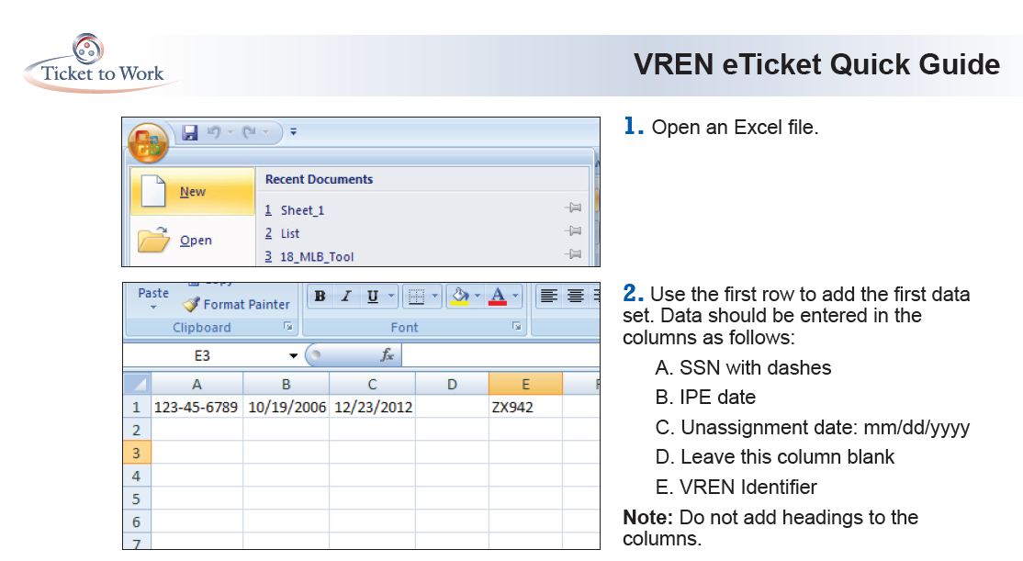
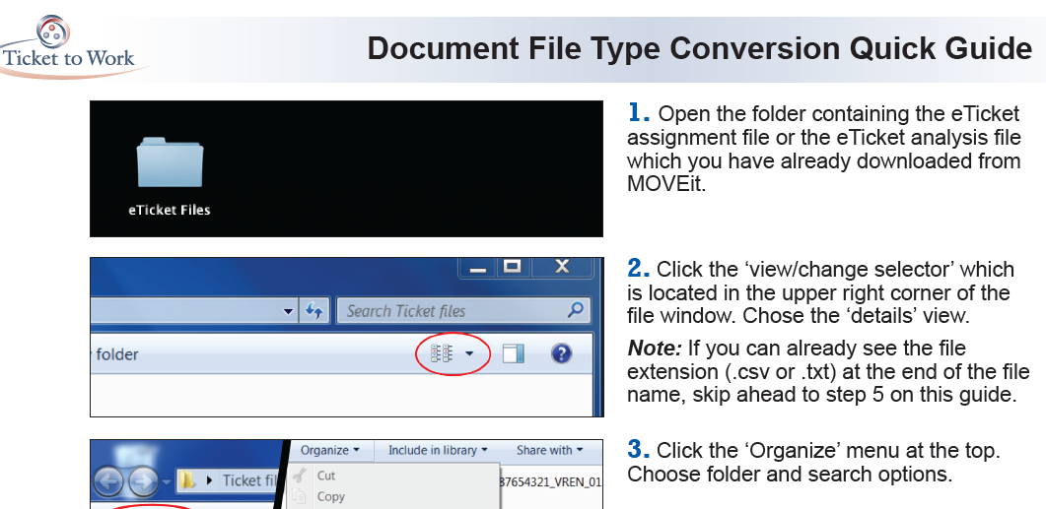
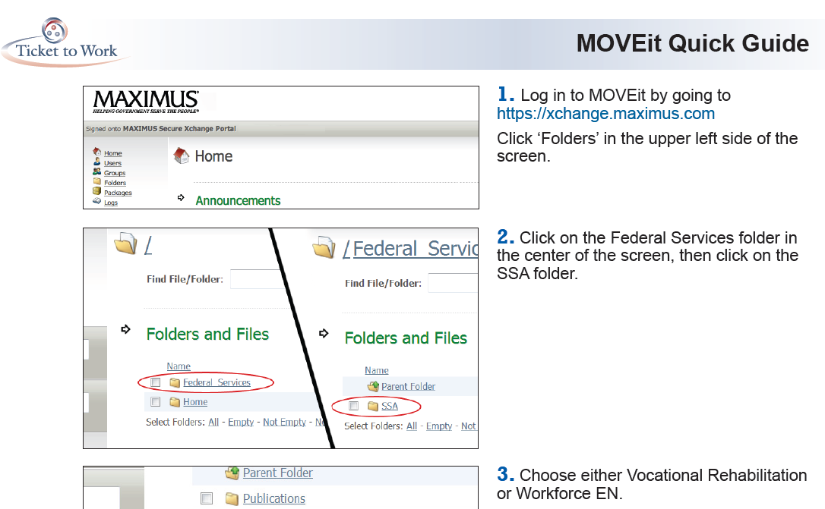
Quick Guides
Notes:
There are three new guides to help you and your staff. The first is a “document file type conversion quick guide” which is designed to help you convert files from the .txt format to the .csv format and vice versa. This is important especially for uploading that eTicket assignment file to MOVEit because the format must be .txt. The second guide is called the “VREN eTicket Quick Guide” which helps you when creating that eTicket assignment file and preparing it for uploading. The third guide is a MOVEit quick guide which reminds you how to navigate to your upload and download folders. It also shows you how to upload those assignment files and download the analysis files. These three guides have been sent to you and are available on the website under the VR tab.

Slide 13
Open Discussion

