Slide 1
Effective Practices Webinar Series Integrating Ticket into Current Business Models and Partnering with Others June 4, 2015
Notes:
The first slide is the title slide. Title should be 28 point font Arial Bold. The subtitle, in the case of the Effective Practices Series, will be the topic for the month and should be 24 point font Arial. Your title slide should also include who is sponsoring/holding the event and the date of the presentation. Follow the format shown above.

Slide 2
Presenter
Kenneth Williams
Ticket to Work Program Manager
Adelante Development Center in New Mexico
Notes:
The next slide should list all of the presenters for the webinar.
This and all other subsequent slides should contain a title in 32-point font Arial. Do NOT make the font larger. All bullets should be 24 point font Arial. Sub-bullets should be 20 point font Arial. Do NOT use any other font but Arial.

Slide 3
Objectives
How to integrate Ticket to Work program (Ticket program) into your current business model
How to market services to individuals with disabilities
How to partner with community agencies
Notes:
The third slide of your presentation should serve as a key learning objectives slide. This slide should contain four to five learning objectives for the presentation.
This and all other subsequent slides should be 32-point font Arial title. Do NOT make the font larger. All bullets should be 24 point font Arial. Sub-bullets should be 20 point font Arial. Do NOT use any other font but Arial.

Slide 4
Integrating Ticket to Work
Ken Williams
Adelante Program Manager since 2010
Approaches used developing Adelante’s Ticket program since 2008
In-reach or internal approach using established contracts through NISH (Source America), to run a Federal training facility, along with Enterprises to employ persons’ with disabilities
Borrowed time initially from staff to slowly establish processes for Ticket program and establish a revenue stream
Notes:
After the title slide should be an “attention grabber”. This slide comes before covering objectives, agenda, logistics, ground rules, expectations, etc.). Grab participant attention right away through an engaging or humorous story, a startling statistic, a provocative question. Last, take advantage of that initial energy and curiosity participants bring.

Slide 5
Transitioning to dedicated staff
Recognized the need for a dedicated staff person
Borrowing time from staff is a great way to start; success depends on dedicated staff
Dedicated full time staff person hired in 2009
2009 - 2010 focused on Ticket program administrative aspects for client data tracking, screening, recruitment, retention, and billing
Continued to utilize an in-reach approach and slowly established an out-reach or external process for recruitment and placement of individuals in community based employment

Slide 6
Mentoring
Ticket to Success EN in Southern California
Adelante gained understanding of billing process/tracking
NENA (National Employment Network Association)
Non-profit organization, works with Employment Networks (EN) across the country
NENA provides education to ENs on the program, policies and regulations, and provides access to the latest information and resources to make ENs more successful
Notes:
Now that you have the learners attention, presented the objectives, and got the participants thinking about past experiences, now the lesson can formally begin. How you present content is up to you but there are different approaches to take with different types of topics/information. For example:
In teaching plain facts, organize them into some grouping or sequence that helps people “get it.”
In teaching concepts, present the concept and its distinguishing characteristics, and point out how the concept is similar to and different from similar concepts.
In teaching rules and principles, define the rule then describe direct and indirect consequences when the rule is not followed.
In teaching a process—how something works—highlight the input, output, and main phases in the process and provide a flow chart or some similar graphic that shows how the process works.
In teaching a procedure—how a person does something—use a step-by-step approach, describing the whole procedure first then drilling down on the main steps of the procedure.
Presentation Tip:
Use cues to “package” each piece of content and to help your audience take note and make the transition to new topics—for example, "And this is a critical point…"; "Here's an example of what I'm talking about"; or "Now let's look at how we apply these concepts."

Slide 7
Expansion of the Program
Mid-2010 Ticket to Work Program Administrator hired to:
Expand the external recruitment and placement of individuals through community-based employment
Explore partnerships with community agencies
No external recruitment and placement of individuals =
limited number of individuals employed through Adelante
limited growth of the Ticket Program
Notes:
Once a topic is introduced, be sure to provide examples and stories or illustrations to elaborate on and reinforce the content. Ask participants to offer their own stories or examples to help make the content “their own.”
For graphics, use line drawings or photorealistic images whenever possible and appropriate. Do not make the common mistake of overusing clipart which may become distracting to the viewer.
Presentation Tip: Using the Slide Sorter:
The Slide Sorter displays all the presentation slides on one screen allowing the designer to move the slide order and to edit or select slides. To use access the slide sorter, select View/Slide Sorter from the Standard Toolbar, or the icon at the bottom left corner of the screen. Use the Slide Sorter View as a storyboard to plan the slide order you will use. This is also beneficial when you use the same slide layout many times throughout your presentation. Select the slide you will commonly use, copy and past this slide as many times as needed. Using the slide sorter is also beneficial to move the order of slides when necessary. After laying out your storyboard, delete the slide layouts you will not use.

Slide 8
Additional training
New Program Administrator traveled to CA to train with Ticket to Success EN
Expansion of external recruitment and training allowed for the hiring of a second full time staff person in 2012
Job Developer
I
How could we learn more?
Notes:
After going through a few of her own slides, Jane Doe will do a recall of learning and then hand off the presentation to the next presenter, in this instance Joe Schmoe. As we know, understanding new information requires an understanding or application of existing knowledge or skills. This is why it is important before presenting new information to try to bring to memory a relatable prior learning experience. This is different from the attention grabber in that the attention grabber is usually shocking or an exaggeration of some sort. The recall of learning is intended to get the learner thinking on past experiences and how it can be applied to this new learning event. For example, the recall of learning in this presentation would be asking:
When sitting through a presentation, what do you find helpful?
Have you received a compliment that stands out for you after creating/delivering a presentation? If so, what did you do, If not what could you have done better?
Do you have any experience with creating a presentation, what would you like to learn this time around?

Slide 9
Key Components to Success
Recruitment/screening/Individual Work Plan (IWP) development
Job development i.e. providing job leads, assisting with applications, developing resumes, cover letters, mock interviews, etc.
Retention/case management/career advancement
Evidence of earnings/billing
Administrative

Slide 10
Full Time Staff
Continued exploring ways to increase external recruiting
Attended job development training provided by Human Solutions EN in California
Training focused on development of documents
Resumes, cover letters, etc.
New techniques in keeping individuals motivated and organized
How these techniques can be applied to virtual job developing

Slide 11
How to Recruit Ticket Holders
External Partnerships: Community agencies serving beneficiaries
American Job Center (Mid Region Council of Governments EN)
Benefits to this partnership:
Creates revenue stream for both agencies
Creates an additional pipeline for recruitment
Affords additional resources for both agencies
Provides specific services for individuals with disabilities
Dedicated staff for the purpose of Ticket program

Slide 12
How to Recruit Ticket Holders
Internal: Programs Adelante had in place
Supported Employment Program
Screening to identify those who fit Ticket program with potential to result in Partnership Plus handoff.
Used Ticket staff to place these individuals in employment
After 90 day VR closure, developed IWP and submitted for ticket assignment under Partnership Plus
Supplements revenue while creating potential for longer term revenue under Partnership Plus
Supported Employment program can now bring in more referrals

Slide 13
Community Work Incentives Coordinator (CWIC)
Ticket to Work Program Administrator attended CWIC training provided through Virginia Commonwealth University
Provides the ability to educate Ticket Holders on the advantages of going to work and the availability of special work incentives to support their efforts during this transition

Slide 14
Partnership Plus
Collaboration of the NM State Vocational Rehabilitation (VR) agency and Adelante in the development of Partnership Plus agreement
Partnership Plus handoffs
Phase 2 and Outcome payments

Slide 15
Successes
Adelante and partnering American Job Center realizing shared revenue - both Ticket programs continue to grow
Expansion of services areas in July 2013 to cover 6 additional states: Arizona, Texas, Colorado, Utah, Nevada, and California
Virtual job development services are available in each of these states *The process that Adelante uses was developed by Human Solutions*

Slide 16
Approaches to consider
Borrowing staff time initially slowly transition to dedicated staff
Internal and external recruitment and placement
Diversification through community partners
Notes:
After all covering all topics, close by (1) summarizing the key points—not verbatim but through rephrasing and perhaps a "one last thing to think about" anecdote—and (2) suggesting ways to apply what they have just heard to their own personal and professional lives. Get participants to decide what they will do with the knowledge and skills they have learned.

Slide 17
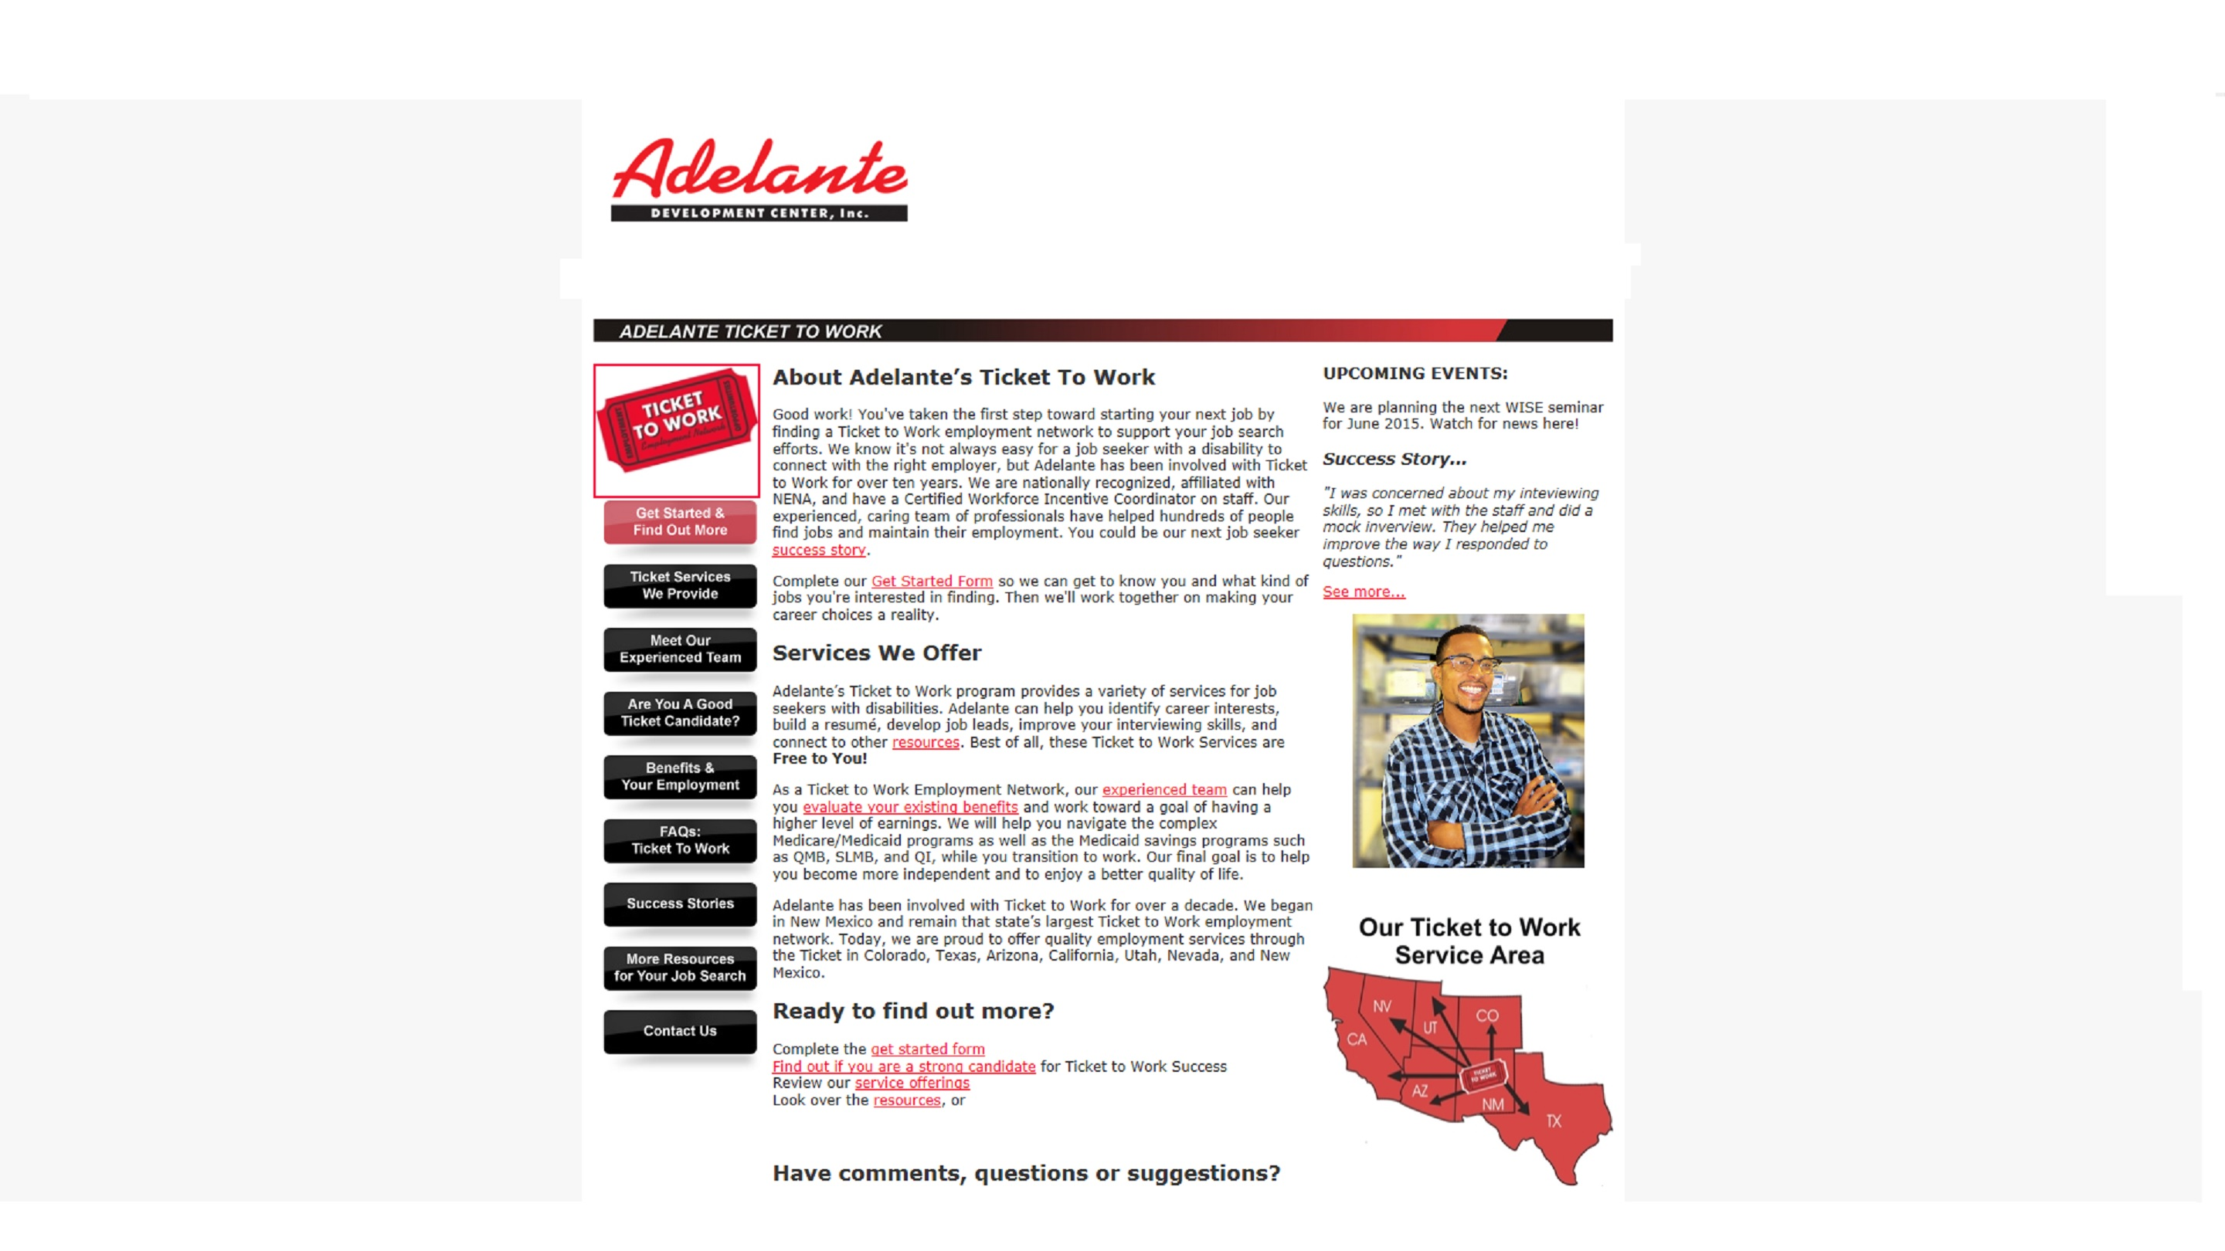
Additional Marketing through website

Slide 18
Comments or Questions?
Ken Williams Ticket to Work
Program Manager Adelante Development Center kswilliams@goadelante.org (505) 341-7131
Notes:
Always have a thank you slide as the closing slide. Use this slide to list your contact information should the audience have further questions.

