Slide 1
Ticket to Work Program
Timely Progress Review Basics
Notes:
The topic for today is Timely Progress Review.

Slide 2
Objectives
Discuss Timely Progress Review (TPR) fundamentals
Discuss how the Ticket to Work Program impacts Continuing Disability Reviews (CDR)
Discuss TPR requirements
Describe the TPR process including TPR appeals and re-entries
Describe the responsibilities of service providers as related to the TPR process
Discuss the TPR implementation schedule
Identify resources available to service providers
Notes:
Now let’s look at the objectives of this session.
Discuss Timely Progress Review fundamentals
Discuss how the Ticket to Work Program impacts Continuing Disability Reviews
Discuss TPR requirements
Describe the TPR process including TPR appeals and re-entries
Describe service provider responsibilities in the TPR process
Discuss the TPR implementation schedule
Identify the TPR resources available to service providers

Slide 3
Timely Progress Review Fundamentals and Continuing Disability Review Protection
Notes:
We will now discuss Timely Progress Review fundamentals and Continuing Disability Review protection.

Slide 4
Timely Progress Review Fundamentals
The Social Security Administration’s way to track the progress of a Ticket holder
Review conducted about every 12 months
Impact upon CDR protection very complex
Assignment, progress made by the beneficiary, or payment of services by or to the service provider does not guarantee protection from CDR. Must consider all aspects of in-use/not in-use status (past TPR failures, successful TPR re-entries, etc.).
Service providers assist beneficiaries through the TPR process
Notes:
What, exactly, is a Timely Progress Review?
A TPR is the Social Security Administration’s way of tracking the progress of a Ticket holder under the Ticket to Work Program. Essentially, SSA expects Ticket holders to make progress towards financial independence while their Tickets are in in-use status.
TPR is based on guidelines established by SSA through regulations effective July 2008. We will introduce the specific guidelines later in this session.
In general, the TPM conducts a review at the end of approximately every 12-month period of active Ticket use to determine if beneficiaries are making the expected progress. At the same time, the portal is open for service provider input. A TPR pass entitles the beneficiary to medical CDR protection, meaning disability benefits continue.
Usually, CDR protection is granted to beneficiaries involved in the Ticket to Work Program who have Tickets in assigned status and are making timely progress.
However, very important is that assignment, progress made by the beneficiary, or payment of services by or to the service provider does not guarantee protection from a CDR. You must consider all aspects of in-use and not in-use including past TPR failures, successful TPR re-entries, etc.
As a service provider, it is important to fully understand and support the TPR process, and to assist beneficiaries not only in making timely progress, but also in providing necessary information to the TPM or to you to verify that progress.

Slide 5
Protection from Continuing Disability Review
CDR – medical review that determines disability benefits eligibility
Ticket to Work – initially, no CDR for about 12 months
CDR exemption renewed for about another 12 months if pass TPR
Notes:
What is a CDR? A CDR is a medical review the beneficiary must undergo in order to determine whether he or she is eligible to continue receiving disability benefits. Initially, one of the biggest advantages of participating in the Ticket to Work Program is that the beneficiary is protected from these reviews while the Ticket is assigned. This exemption will be renewed for about another 12 months if the beneficiary passes TPR.

Slide 6
Timely Progress Review Requirements Not Met and CDRs
Ticket remains assigned to service provider
CDR protection lost
CDR not conducted immediately upon loss
Rather, CDR conducted when regularly scheduled
2012
Beneficiary began receiving benefits with CDRs scheduled every 3 years
2013
CDR conducted
2014
2015
TPR requirements not met; CDR protection lost
Ticket assigned to EN/VR
Notes:
With TPR, if the requirements are not met, the Ticket will remain assigned to the service provider. But, the beneficiary is no longer protected from CDRs.
As you can see, the CDR is not conducted as soon as the protection is lost. Rather, it is conducted when it would have been conducted if the beneficiary had not participated in the program.

Slide 7
Timely Progress Review Requirements
Notes:
Next, you can see the TPR requirements which are sent with most TPR notices.

Slide 8
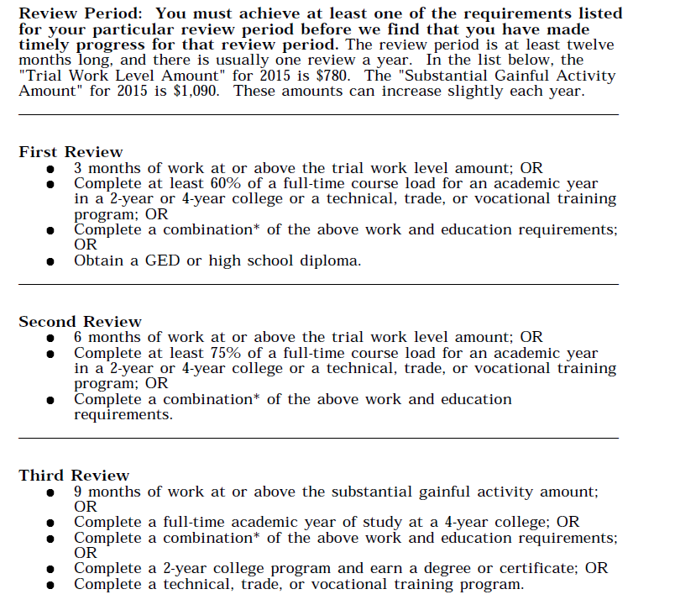
Timely Progress Review Chart

Slide 9
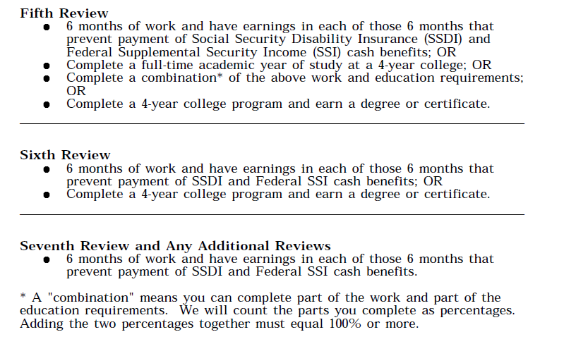
Timely Progress Review Chart
Notes:
Here are the TPR requirements, reflecting the 2008 regulations. These represent the work and education requirements which must be met at each review level. 10% tolerances for earnings are acceptable in reviews 1-4. And 10% tolerances for education are acceptable in reviews 1-5. Tolerances will be covered in the portal training.
For example, the 1st review requires that a beneficiary completes 3 months of work at the trial work level, or receives a GED or high school diploma, or completes 60% of a full-time course load for an academic year in a college, or trade, technical, or vocational training program, or completes a combination of this work and education requirement.

Slide 10
Timely Progress Review Process
Notes:
We will now discuss the TPR process.

Slide 11
TPR Process
Step 1
Earnings Check = Social Security Guidelines
TPR Met
Step 2
Earnings Check ≠ Social Security Guidelines
SSA sends notice to beneficiary; portal open for input
Notes:
Here is a brief overview of the process which will be explored in greater detail today.
In Step 1, SSA checks the earnings records of those beneficiaries selected that month for TPR. If the earnings are sufficient, meaning that they meet the guidelines set forth by SSA, then no further actions are taken, and the beneficiary continues along the path of self-sufficiency, unaware that a check was even made.
However, if the beneficiary’s earnings are insufficient, then SSA contacts the beneficiary via mail, sending a TPR Selection Notice. At the same time, the portal is open for TPR input by the service provider.

Slide 12
TPR Process – Step 2
Selection criteria are very complex including such factors as current pay, CDR classification, assignment, and previous TPR history. Most important, selection will begin very slowly, with probably 50 cases selected nationwide the first month.
If selected for a TPR, SSA sends the Selection Notice to the beneficiary at the conclusion of about every 12-month period of Ticket in-use status. This is to determine if the beneficiary is making the expected progress with work and/or education.
At the same time, the SSA portal is open for 55 days to all service providers for TPR input. The service provider can only pass the beneficiary.
If the TPM receives the SSA-1375 (part of the Selection Notice) from the beneficiary, the service provider has not passed the beneficiary, and the time frames are acceptable (within 55 days), the TPM opens a case and begins a review
Notes:
Selection criteria are very complex including such factors as current pay, CDR classification, assignment, and previous TPR history. Most important, selection will begin very slowly, with probably 50 cases selected nationwide the first month.
So for Step 2, if the beneficiary is selected for a TPR, SSA sends the Selection Notice to the individual at the conclusion of about every 12 months of Ticket in-use status. This is to determine if the beneficiary is making the expected progress with work and/or education.
At the same time, the SSA portal is open for 55 days to all service providers for TPR input. The service provider can only pass the beneficiary.
If the TPM receives the SSA-1375 from the beneficiary, the service provider has not passed the beneficiary, and the time frames are acceptable (within 55 days from date of notice), the TPM opens a case and begins a review. We plan to have extensive TPR portal training well before TPR implementation.

Slide 13
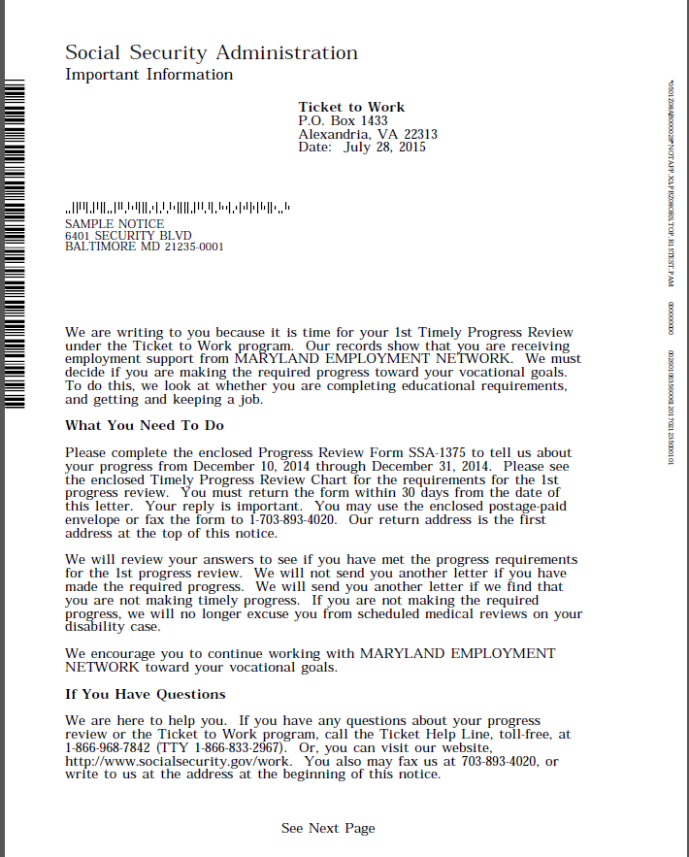
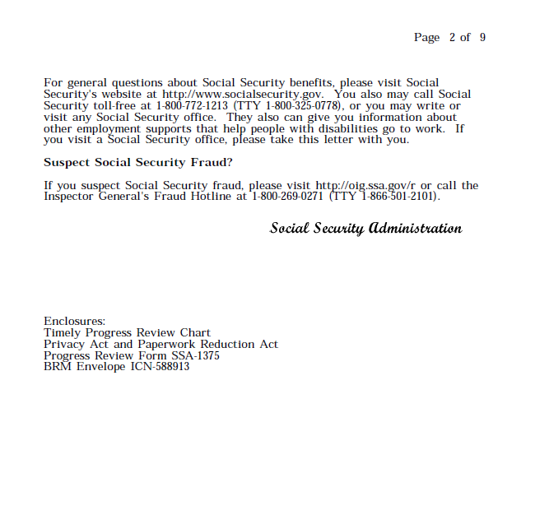
TPR Selection Notice

Slide 14
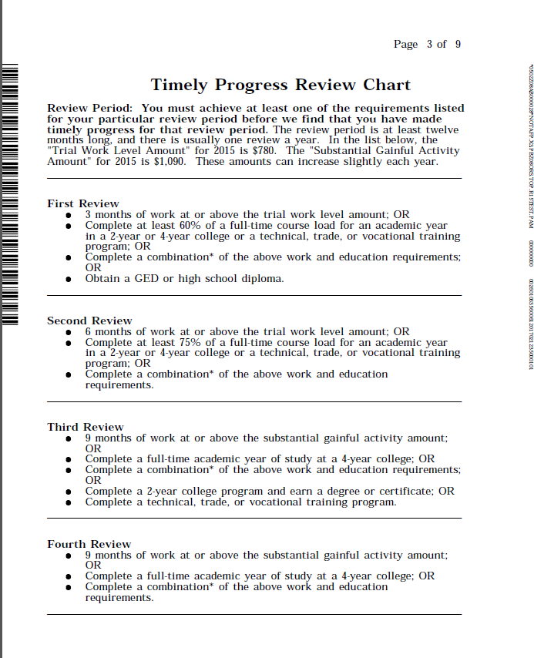
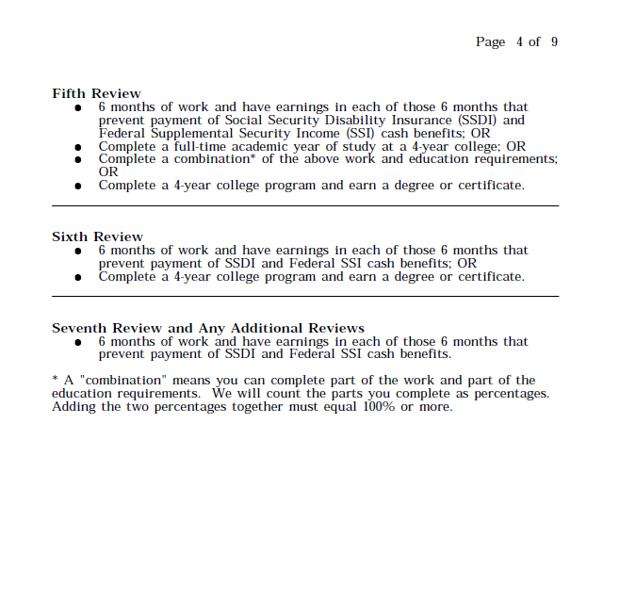
TPR Selection Notice cont’d

Slide 15
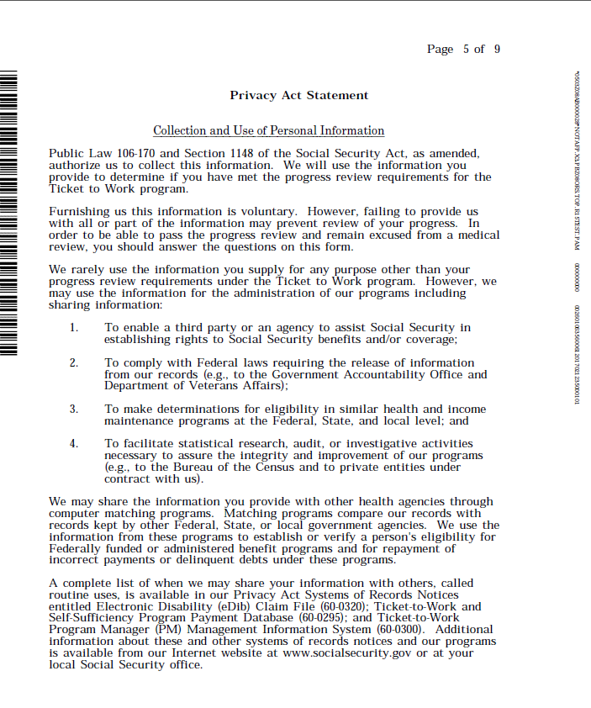
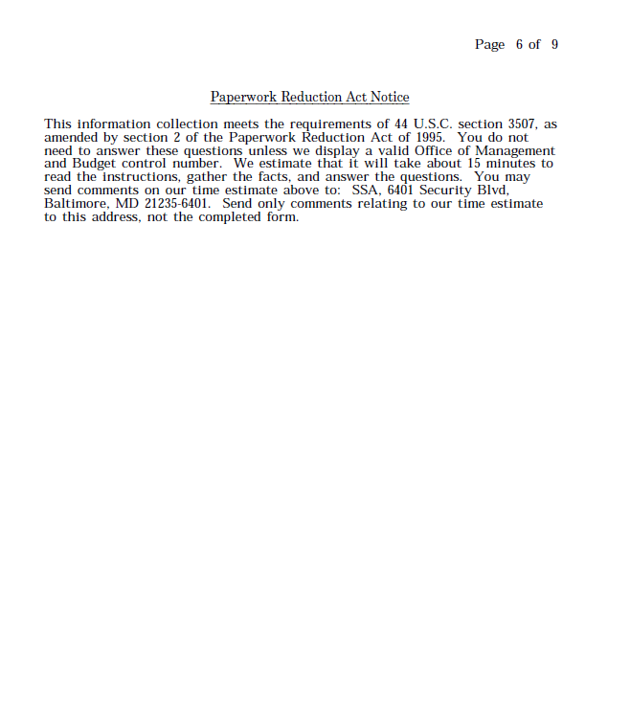
TPR Selection Notice cont’d

Slide 16
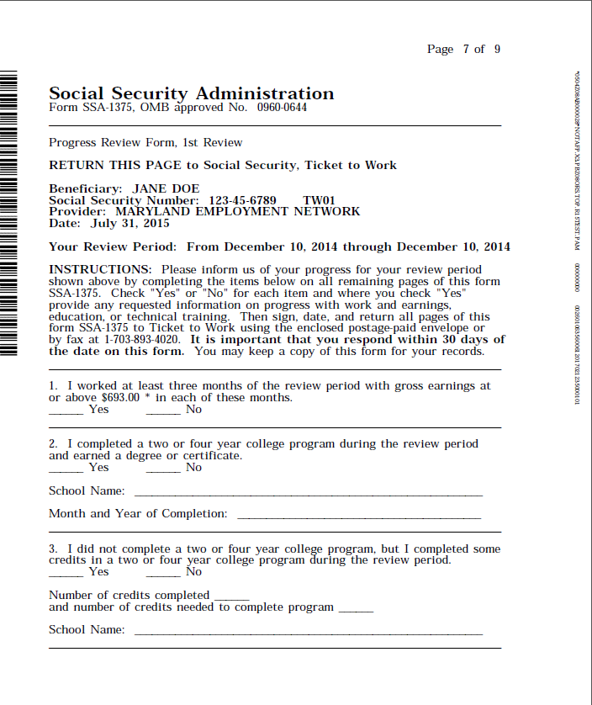
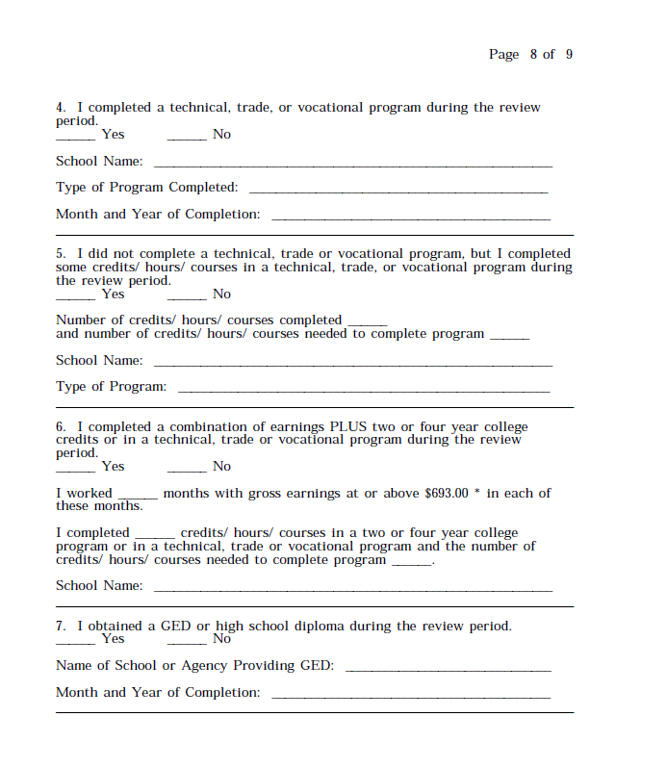
TPR Selection Notice cont’d

Slide 17
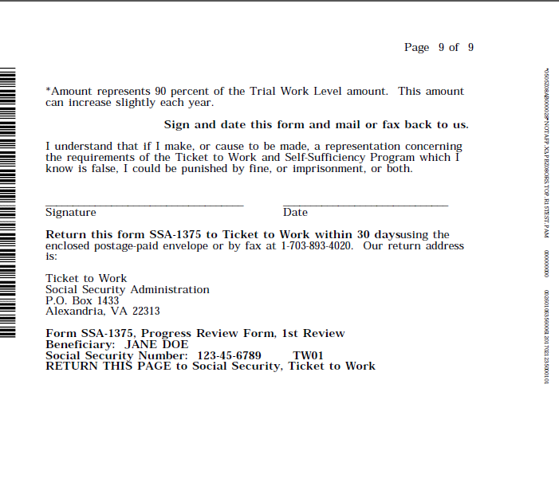
TPR Selection Notice cont’d
Notes:
This is an example of the TPR Selection Notice received by a beneficiary. The notice is tailored to the person, including review level, review period dates, requirements, questions, etc. Specific earnings amounts are listed which allow for a 10% tolerance in reviews 1-4. No mathematical calculations are required by the beneficiary. All notices give the beneficiary 30 days from the notice date to respond. The timeframe is generally 55 days in order to allow for mail time/contract time.

Slide 18
TPR Decisions - Pass
CDR protection is extended for approximately 12 months
No follow-up letter is sent regarding pass
Beneficiary will receive the next review after about another 12 in-use months
Notes:
So with a pass, CDR protection is extended, no letter is sent, and the next TPR will be in about another 12 months of in-use.

Slide 19
TPR Decisions - Fail
The Proposed Failure Notice is sent explaining the option to appeal (SSA Review)
If the failure is upheld, CDR protection ends following the appeal period and beneficiary is subject to regularly scheduled medical reviews
No future TPR selections are made without a favorable subsequent action
Assignment/re-assignment usually not affected by a proposed failure or a final failure, but must be in current pay
Notes:
If the beneficiary fails TPR, the Proposed Failure Notice is sent giving an option to appeal. Benefits are not affected. The beneficiary maintains CDR protection for 55 days from the date of notice release, and through the appeal processing. The individual is subject to regularly scheduled CDRs once the final failure is effective. Assignment and re-assignment are not usually affected by a proposed or a final failure, but must be in current pay.

Slide 20
TPR Appeals and Re-Entries
Notes:
Now we will discuss appeals and re-entries.

Slide 21
SSA Review – Appeal
Beneficiary has 55 days to submit a request to appeal the decision
Unlike the initial review, the request must contain evidence of progress made
Acceptable forms of evidence include copies of paystubs, copies of transcripts, copies of certificates, etc.
Request may be faxed or mailed to the TPM
SSA makes the final decision
The decision is mailed to the beneficiary
Notes:
For appeals, the beneficiary has 55 days from date of the Proposed Failure Notice to submit a request for appeal. The request must contain supporting documentation. Requests can be mailed or faxed to the TPM. SSA makes the final decision in appeals. And decision notices are released to the beneficiaries.

Slide 22
TPR Re-Entry - Successful
Beneficiary earns approximately 12 additional months of CDR protection
Beneficiary notified of decision by mail
In accordance with SSA regulations, in-use status is effective the month/year of the notice
Notes:
After failing a TPR, evidence can be submitted at any time to show that the requirements of the review period have been met. The Call Center will instruct the beneficiary as to what is needed. If successful, the individual earns approximately 12 additional months of CDR protection. In-use status is effective the month/year of the notice. A desicion notice is released.

Slide 23
TPR Re-Entry - Failure
Will show no change to existing status of not in-use
Beneficiary is notified by mail of the unsuccessful attempt to re-enter TPR
Beneficiary has 30+ days to appeal the failure decision by fax or mail to the TPM
Notes:
In this case, the beneficiary will still be not in-use. There will be mail notification of the unsuccessful action. And the person has 30+ days to appeal the decision.

Slide 24
Schedule
Notes:
We will discuss the tentative TPR implementation schedule.

Slide 25
Tentative Schedule
Portal training – end of October 2016
TPR selections – no earlier than November 2016
Notes:
As you can see, portal training for all service providers will take place probably at the end of October, with selection to begin slowly in November.

Slide 26
Service Provider Responsibilities
Notes:
It is important that you understand your responsibilities to your clients.

Slide 27
Timely Progress Review Responsibilities
Understand the process
Input to portal
Answer questions about TPR
Ensure understanding by beneficiary
Encourage a timely response to any requests for additional information
Provide counseling and advice
TPRhelpdesk@yourtickettowork.com for questions
Notes:
You need to understand the TPR process so you can explain the existence of TPR reviews and how they work. It is important that your beneficiaries fully understand TPR and what the consequences are for not making timely progress. You will also want to discuss the importance of providing timely information to the TPM or to you as part of the process. Additionally, beneficiaries will often come to you with questions regarding TPR. This is especially true when TPR Selection Notices are received by your clients. If you are not able to accurately address the issues, you should contact the TPM. And finally, it is your responsibility to input TPR information to the portal.

Slide 28
Questions
Notes:
Questions.

Slide 29
Additional Information
Contact the TPM at TPRhelpdesk@yourtickettowork.com
Notes:
For additional information, please contact the TPM at this address.

