Slide 1
Quarterly All Employment Network (EN) Call
There will be audio silence until the call starts at 1 p.m. ET
March 17, 2026

Slide 2
Quarterly All Employment Network (EN) Call
March 17, 2026

Slide 3
Meeting Logistics
This meeting is being recorded and transcribed. Presentation materials from today’s call will be made available within two weeks.
Per the Ticket Program Agreement (Part III, Section 11 subsection I), EN staff are not permitted to record this meeting nor capture the transcript.​
Closed Captioning is available for participants who join using the MS Teams Application or by using the separate Closed Captions link provided in the GovDelivery email announcement for today’s call. ​
To turn on Closed Captions in MS Teams, go to the three ellipses at the top of the MS Teams window, click on “More ,” and go down the list to “Language and Speech” and select “Turn on live captions”. ​
When using the link option, paste the link in the browser and it will open a separate window to view Closed Captions.

Slide 4
Meeting Logistics Continued
Please feel free to ask a question in the MS Teams chat section.​
There will be a live Q & A session during today’s call.
If joining via phone and you wish to ask a question:
Raise your hand using *5, and you will be unmuted by the Facilitator.
Then press *6 to speak.
If joining via MS Teams and you wish to ask a question aloud:
Raise your hand and your mic will be unmuted upon by the Facilitator.
Please limit questions to one per participant. Additional questions or comments can be sent to ENOperations@ssa.gov.
Those questions not answered during the live event will be forwarded to the appropriate panelists for response.
Thank you in advance for your participation!​

Slide 5

Agenda
Welcome, Meeting Logistics, Agenda Review – ​Derek Shields​
Suitability Updates – Vernon Collins
Question and Answer Session 1
Employer EN Model and EN Site Visits – Patrice McLean
Ticket to Work Survey – Ellie Stinnett
Social Security Updates – Erinn Weidman​
Communications and Outreach Update – ​Jayme Pendergraft​
Question and Answer Session 2

Slide 6

Welcome to New ENs
Weave Solutions LLC - NV
Jewish Family Services of Washtenaw County Inc. – OH
NewView Oklahoma – OK
Eagle Rehabilitation Services Inc. – MD
Land of Goods LLC – FL
Diverse Paths & Solutions LLC – WI
Abundant Life Employment Services LLC – ID
2nd Chance at Living – TN
Talento Hispano Solutions LLC – FL
Mountain Employment Training LLC - CO

Slide 7
Suitability Updates
Vernon Collins, Supervisory Personnel Security Specialist, Social Security Administration

Slide 8
Employment Network Contractor Suitability Submission Process Updates
Personnel Security Suitability submissions mailbox: SecRes.PerSec.Contractor.Vetting@ssa.gov.
Fingerprint completion will now be required prior to the submission of the Applicant Listing, OF306, and work authorization (if applicable) documents to start the initiation process. An updated Applicant Listing form will be distributed following this quarterly call with an added column for fingerprint completion.
If you are submitting an applicant that previously worked under your Employment Network, another Employment Network, another SSA contract, or is a former SSA employee, you can email your POC or the Suitability mailbox beforehand to see if fingerprints are required.
Applicants will now be required to submit the application within 5 days after initiation. Typically, applicants should receive the invite in their personal email the day after you submit the required documentation.
Why are we making these changes?
Improve our timeliness metrics with the Defense Counterintelligence and Security Agency (DCSA).
Faster suitability decisions for SSA contractors.
Minimize the number of applicants who never complete any steps of the process.

Slide 9
Employment Network Contractor Suitability Upgraded Risk Level
All Employment Network applicants will now complete a Moderate Risk (T2) application. After the review of specific duties, responsibilities, and access levels, the updated designation dictates the appropriate investigative form and type required for personnel vetting. There are no additional requirements for the Employment Networks as the submission process is the same.
Identifying Information (Last Name, First Name, Middle, DOB, POB, SSN)
Identifying Information (Height, Weight, Hair, Eye, Sex)
U.S. Passport Information
Dual Citizenship
Where You Went to School
Selective Service Record
People Who Know You Well (3)
Relatives
Police Record
Investigations and Clearance Record
Use of Information Technology Systems
Association Record
Contact Information (email addresses, phone numbers)
Citizenship
Where Have You Lived (7 years)
Employment Activities (7 years)
Military History
Marital/Relationship Status
Foreign Travel
Illegal Use of Drugs or drug Activity
Financial Record
Non-Criminal Court Actions
*Investigator interview (verify investigator information below)
dcsa.boyers.bi.mbx.investigator-verifications@mail.mil
878-274-1186 – Hotline is open Monday - Friday, 7 a.m. - 4 p.m. ET

Slide 10
Employment Network Contractor Suitability Current Personnel Upgrades/Informational
We will be reaching out to upgrade current personnel over the course of the next year or two. The upgrades are quick as previously entered information populates and in 99% of the cases, we do not require fingerprints.
If your Employment Network would like to volunteer, please let us know and we can generally complete your entire roster in less than 10 days.
General Reminders:
If an applicant’s SSN or DOB is incorrect in the eApp system, contact your POC and/or the Suitability mailbox instead of calling the NBIS Help Desk. They are not able to correct the SSN or DOB.
If an applicant did not get the email to log into the system, contact your POC and/or the Suitability mailbox instead of calling the NBIS Help Desk. We will verify your email and send out another request.
The Suitability approval letters we send out is just the beginning of the investigation process:
Unacceptable returns from DCSA may require additional information from the applicant.
Final adjudication, which normally happens in the background, may require additional information.
Coming Soon – DCSA applicant Portal that allows subjects to follow their investigation status through the entire process.

Slide 11
Questions
MS Teams
Enter your question into the chat or raise your hand and you will be unmuted by the Facilitator.
By Phone
Raise your hand by dialing *5 and you will be unmuted by the Facilitator. Then press *6 to speak.
Please state your first name, EN name, and ask your question.​

Slide 12
Employer EN Model and EN Site Visits
Patrice McLean, Employment Support, Social Security Administration

Slide 13
Employer EN Business Model Changes
Employer EN includes serving as:
The Ticketholder’s employer or
An employer agent (i.e., being compensated by an employer via contract, agreement or other working arrangement to locate and place suitable job candidates)
Change: We are going to absorb the Employer Employment Network business model into the Traditional EN business model.
Purpose: To streamline the operations of ENs serving in the Ticket Program and reduce the burden on organizations that want to employ Ticketholders and assist others with their return to work.

Slide 14
Employer EN Business Model Changes Continued
Traditional ENs will now be able to hire Ticketholders without submitting an RFA to serve as an Employer EN.
Existing Employer ENs will be able to continue providing services as an Employer of their Ticketholders, or the employer agent, as a Traditional EN.
As a Traditional EN, previous Employer ENs will also be able to provide other services, and support Ticketholders that are not employed by their EN.
We met with Employer ENs on March 6 to communicate this change and all associated requirements. RFAs to transition from Employer ENs to Traditional ENs are due March 20, 2026.
SSA will change Employer EN business model types to Traditional ENs on March 31, 2026.

Slide 15
EN Site Visits
SSA plans to resume site visits to ENs in FY26.
SSA staff will visit each selected EN for one day to check records, validate data, recommend or provide training, and provide technical assistance and subject matter expertise as needed.
Site visit objectives:
Conduct a comprehensive review of operational procedures, report inadequacies and ensure such necessary corrections, review Ticket enrollment status, assess payments, and respond to questions.
Confirm adherence to the Ticket Program Agreement, including PII security and ADA compliance.

Slide 16
EN Site Visits Continued
If selected for a site visit, SSA or TPM will reach out to the EN's Signatory Authority and Program Contact to schedule a date and time.
We will visit the EN (likely at their primary location) and engage in discussion about the EN’s business practices.
We will review IWPs and case notes and provide feedback.
We will answer EN questions and ask for any EN recommendations.
We will send a comprehensive report of the visit to the EN after the visit and assign any necessary corrective actions.

Slide 17
How to Prepare for a Site Visit
Have IWPs, case notes, and any EN business process documentation available for review.
Ensure EN staff that work with Ticketholders and understand the EN’s Ticket operations are available to attend the Site Visit.
We will include additional details on what/how to prepare in the Site Visit invitation, which will arrive via email.
Due to resource limitations, all ENs will not receive a Site Visit, but we hope to continue conducting visits each year.

Slide 18
Ticket to Work Survey
Ellie Stinnett, Employment Support, Social Security Administration

Slide 19
Ticket to Work Survey and Interviews
SSA is evaluating the Ticket to Work Program to help SSA understand best practices and identify potential improvements.
Survey: Mathematica will email a link to the survey to the Program Contact at each EN ($40 check for completion).
Interviews: Mathematica will contact Ticketholders by mail and phone inviting them to be interviewed ($40 gift card for completion).
Please complete the survey and encourage your Ticketholders to participate in the interviews, if contacted.
For questions: Eleanor.Stinnett@ssa.gov

Slide 20
Social Security Updates
Erinn Weidman​, Employment Support, Social Security Administration

Slide 21

Social Security Updates
Annual Performance Outcome Report (APOR)
Security Awareness Certification
EN Service Reminders

Slide 22
EN Service Reminders
Main EN Point of Contact Roles
Signatory Authority – Primary EN official recognized by SSA as authorized to represent and speak for the EN in communications with SSA in matters relating to the administration of the TPA, including signing off on TPA amendments.
Program Contact – Responsible for all the EN’s day-to-day operations, including signing off on TPA changes.
Suitability Contact - Designated security officer/suitability contact that serve as a liaison with SSA on matters relating to systems security, privacy, and employee suitability, including submitting and tracking suitability applications.
Ticketholder Contact - Main point of contact for Ticketholders contacting the EN to inquire about their supports and services. Also, responsible for responding to all inquiries from SSA or the TPM regarding currently assigned Ticketholders.
Payments Contact - Responsible for overseeing all aspects of payment tracking, including managing payment inquiries from SSA or the TPM, and ensuring accurate payment requests and records in the Portal.
Ticket Portal User - Responsible for Ticket assignments, status, and payment. The Signatory Authority or Program Contact designates their Ticket Portal users based on the EN's business need by submitting a TPA change form.

Slide 23
EN Service Reminders Continued
How to Confirm Your EN’s Main Points of Contact - If you are unsure who your EN’s main points of contact are (i.e., Signatory Authority, Program Contact, Ticketholder Contact, Suitability Contact, or Payment Contact), have a portal user complete the following steps:
Log in to the Ticket Portal.
Navigate to “About your EN and SVR” on the main screen.
Select “View directory information about your EN or SVR” to review the listed contacts.
Use of official legal name for TPA, Suitability, Training records, etc.
If an EN employee legally changes their name, complete the following steps:
The EN Company Point of Contact (CPOC) should notify their main SSA EN Contractor Suitability POC
Complete and submit a TPA Change Form to ENService@ssa.gov
The EN employee should report to a local SSA Field Office to update SSA’s mainframe record.
Full name not short version; i.e., Robert instead of Rob, Bob, Bobby.
Official business email address that represents the EN instead of personal email addresses (gmail or others) or a generic email business address like inquiries@myEN.com.

Slide 24
Communications and Outreach Update
​Jayme Pendergraft​, Ticket Program Manager

Slide 25

Ticket Connection Newsletter
TPM published and announced the Ticket Connection Winter Edition:
Sent by GovDelivery message on January 21.
Posted here: Ticket Connection Winter 2026
Topics include: Checklist for Services and Supports reviews, Ticket to Work Evaluation, wage reporting, suitability updates, new Ticket to Work posters, and upcoming events.
Please contact ENOperations@ssa.gov with ideas for future editions.

Slide 26

Marketing Materials: New Posters
A new Ticket to Work poster is now available: Marketing Materials | Ticket to Work
Designed to help providers promote the Ticket to Work Program consistently with official Social Security branding.
How Providers Can Use It
Download the poster directly from the Marketing Materials page. Available in 2 sizes: poster and flyer.
Print and display it in offices, community spaces, or partner locations to increase program visibility.
Use alongside other official branding materials to maintain consistent messaging across outreach channels.

Slide 27

Introduction to Ticket to Work Video

Slide 28

Work Incentive Seminar Event (WISE) Webinars
Promote and join us for WISE webinars on the fourth Wednesday of the month! ​
March 25: What is Ticket to Work?
Help clients understand how work affects their benefits with clear, expert-led guidance.
Strengthen your organization’s impact by amplifying resources that reduce confusion and build confidence.
Promote webinars through your newsletters, workshops, and social channels.
Encourage clients to attend live or watch on-demand recordings anytime.
Join the webinars yourself to stay aligned with the guidance your clients receive.

Slide 29
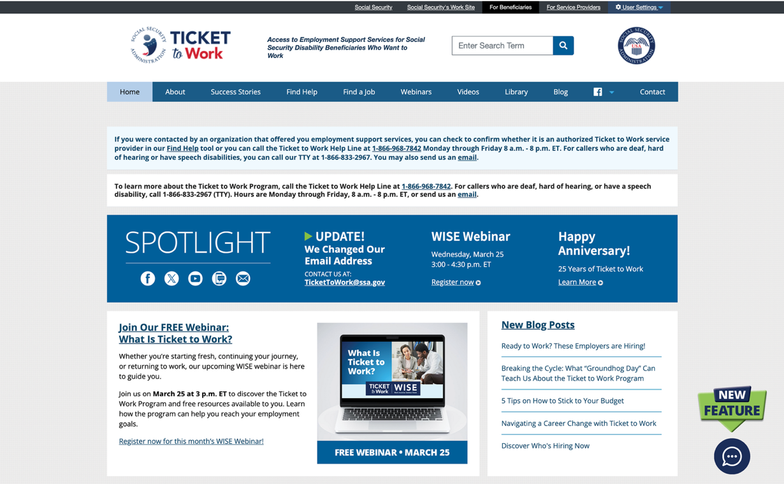
Choose Work New Navigation Tool

Slide 30

Stay in Touch
Share on social media
Facebook: @ChooseWork
X: @ChooseWorkSSA
Submit blog ideas: Email TTWSocialMedia@ssa.gov

Slide 31
Questions
MS Teams
Enter your question into the chat or raise your hand and you will be unmuted by the Facilitator.
By Phone
Raise your hand by dialing *5 and you will be unmuted by the Facilitator. Then press *6 to speak.
Please state your first name, EN name, and ask your question.​

Slide 32

EN Essentials Supplemental Training
Next Event: April 15, 2026, 1 p.m. ET
Topic: EN Marketing - It’s All About Relationships
Both newer and seasoned ENs will discuss ways they engage with Ticketholders using a variety of marketing strategies, outreach to specific groups, and partnerships.
Learn how organizations successfully “braid” an existing client base and other funding with Ticket to Work services to support successful outcomes.

Slide 33

Upcoming Events
March 25: WISE Webinar: What is Ticket to Work?
April 14: All VR Call
April 15: EN Essentials: EN Marketing - It’s All About Relationships
April 22: WISE Webinar
Calendar of Events | Ticket to Work
The Ticket Program shares important information with service providers through GovDelivery messages, including Ticket Portal issues and outages. Please save this email address so that these messages do not go into your spam or junk email boxes: TicketToWork@subscriptions.ssa.gov.

Slide 34

Next Quarterly All EN Call:
June 16, 2026, 1 p.m. ET
Send topic suggestions for All EN Calls to: ENOperations@ssa.gov. ​
Thank you for joining today’s call!

