Slide 1
Section 503 Community of Practice
Disability Disclosure and Self-Identification Part II
and
EN Capacity Building Part II
July 9, 2014

Slide 2
Part I Disability Disclosure and Self-Identification Resources
For Information on Section 503 and to view the Part 1 Community of Practice webinar on Section 503 Voluntary Self-Identification, visit the “Information Center” on the Your Ticket to Work website (www.yourtickettowork.com) in the left navigation. Click on “Events Archive” and then on “503 Community of Practice” to get the to 503 CoP archives and look for the April 2nd Community of Practice on “Self Identification”; or go to: https://yourtickettowork.com/web/ttw/503-community-of-practice
For more information on Section 503 and to retrieve a copy of the “Voluntary Self Identification of Disability” form, visit the Department of Labor’s Office of Federal Contract Compliance Section 503 website at: http://www.dol.gov/ofccp/regs/compliance/section503.htm

Slide 3
Disability Disclosure and Self-Identification Part II
Conversation Facilitators:
Susan Webb, Director, ABIL Employment Services, Phoenix, AZ
Kate Kingree, Ticket to Work Program Manager, ERI Plus Inc., WI
Judy Sanderson, Director of Vocational Services, Granite State Independent Living, NH

Slide 4
Disability Disclosure and Self Identification
How are Employment Networks (EN) preparing their Ticket customers for disability disclosure and self-identification during the application and hiring process?
How often and why during the job application, interviewing and hiring process can disability disclosure and self-identification inquiries be made by an employer?
How are Ticket customers responding to pre- and post- hire self-identification inquiries?

Slide 5
Disability Disclosure Pre-Hire Inquiries
When may an employer ask?
Affirmative Action (Section 503) Purposes:
  Voluntary pre-hire inquiries may be made for affirmative action hiring appointments (non-compete), or to award candidate preference points. Verification of disability may be required.
    Schedule A Federal government hire appointments
    Employer non-compete hiring or preference points (most often seen in state or local government jobs)
  Voluntary pre-hire inquiry must be made by certain Federal contractors and subcontractors to document recruitment efforts. Verification of disability is not required.
    Employers must use the OFCCP “Voluntary Self-Identification of Disability” form.

Slide 6
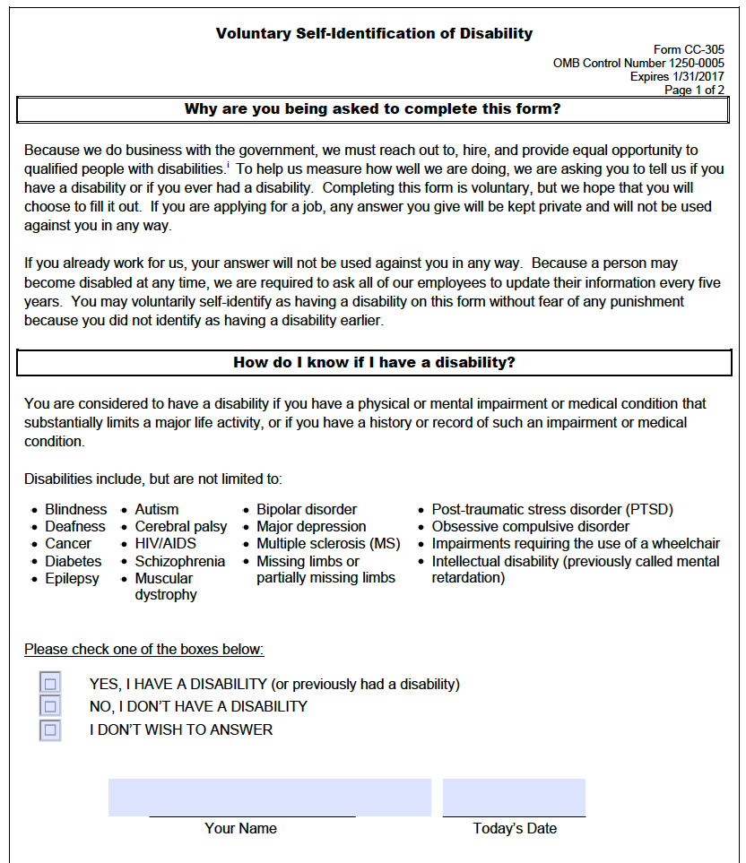
Voluntary Self-Identification of Disability Form
The form that Federal contractor and subcontractor employers must use to ask employees and applicants to self-identify as individuals with disabilities is available on the OFCCP website at:
http://www.dol.gov/ofccp/regs/compliance/section503.htm
Scroll down to Self-Identification for English and Spanish versions of the form.

Slide 7
Disability Disclosure Post-Offer Inquiries
When may an employer ask?
According to the Equal Employment Opportunity Commission (EEOC) and in accordance with the Americans with Disabilities Act (ADA):
  Employers may not ask disability-related questions or conduct medical examinations until after they make a conditional job offer to an applicant.
  Once a conditional job offer is made and before an employee starts work, employers may ask any disability related questions they choose and they may require medical examinations as long as this is done for all entering employees in a particular job category.
  An employer may ask an employee with a known disability whether he/she needs a reasonable accommodation when the employer reasonably believes that the employee may need an accommodation.
    (Source: Employer’s Practical Guide to Reasonable Accommodation under the American’s with Disabilities Act @ http://askjan.org/ERguide/ERGuide.pdf)

Slide 8
Follow Up with the Conversation Leads
Susan Webb, ABIL Employment Services, Phoenix, AZ
Email: SusanW@abil.org
Kate Kingree, Ticket to Work Program Manager, ERI Plus, Inc. Madison, WI Email: kingree@eri-wi.org
Judy Sanderson, Director of Vocational Services, Granite State Independent Living, Concord, NH
Email: jsanderson@gsil.org

Slide 9
EN Capacity Building Part II
Conversation Facilitators:
Pam Walker, CEO, Alliance Professional Services LLC, TN
Ann Austin, Ticket to Work Program Specialist, Laradon, CO
Barbara Rodriquez, Director of Employment Services, EmployRewards Solutions Inc., SC

Slide 10
Part I EN Capacity Building and Sharing
To view the Part 1 Community of Practice webinar on Section 503 EN Capacity Building and Sharing, visit the “Information Center” on the Your Ticket to Work website (www.yourtickettowork.com) in the left navigation. Click on “Events Archive” and then on “503 Community of Practice” and look for the May 7th Community of Practice on “Capacity Building and Sharing”; or go to: https://yourtickettowork.com/web/ttw/503-community-of-practice

Slide 11
EN Capacity Building Part II
How are ENs preparing their Ticket customers to find employment in the Federal contractor job market?
What web-based job posting boards and resume uploading sites are ENs finding helpful?
What strategies are ENs using for locating and/or sharing qualified Ticket customers that can fill job openings with Federal contractors and subcontractors?

Slide 12
Follow Up with the Conversation Leads
Pam Walker, CEO, Alliance Professional Services LLC, Collierville, TN
Email: pam@allianceprofessionalservices.com
Ann Austin, Ticket to Work Program Specialist, Laradon, Denver, CO
Email: ann.austin@laradon.org
Barbara Rodriquez, Director of Employment Services,
EmployRewards Solutions Inc. Florence, SC
Email: BRodriguez@employreward.com

