Slide 1
Annual Performance Outcome Report
Operations Support Manager Social Security’s Ticket to Work program
Lawanda Hawkins, Program Integrity Manager
January 28, 2015
Notes:
Hello and welcome to the Annual Performance Outcome Report webinar. During our time together today we will explore how to successfully complete the Annual Performance Outcome Report, also referred to as the APOR, for the period of January 1, 2014, through December 31, 2014.

Slide 2
Goals and Objectives
At the conclusion of this training you will be able to:
Recognize your responsibilities regarding the APOR.
Complete the questionnaire using the SurveyMonkey link and interface.
Accurately and completely answer each question on the report before submitting.
Notes:
At the conclusion of this training you will be able to:
Recognize your responsibilities regarding the APOR.
Complete the questionnaire using the SurveyMonkey link and interface.
Accurately and completely answer each question on the report before submitting.

Slide 3
APOR Definition
Annual Performance Outcome Report (APOR): The APOR is a report that compiles, on an annual basis, information provided by Employment Networks (EN) on the outcomes achieved by the EN with respect to services the EN offers to Social Security beneficiaries under the Ticket program.
Notes:
Every EN is required to provide information each year to the Operations Support Manager (OSM) on outcomes it achieved with respect to services it offered beneficiaries. Some information provided in the Annual Performance Outcome Report is used, along with beneficiary satisfaction data, to populate the EN Report Card.

Slide 4
APOR as a requirement
As per the RFQ; Part III; Section 10(b), an EN shall provide to the OSM on no less than an annual basis, in a format prescribed by the Social Security Administration, an APOR. The APOR is to provide information on outcomes ENs achieve with respect to services the EN offers to beneficiaries.
Notes:
Completing and returning the APOR to the OSM is mandatory for every EN. As per the EN RFQ, part III, section 10(b), an EN shall provide to the OSM on no less than an annual basis, in a format prescribed the Social Security Administration, an APOR.

Slide 5
APOR Framework
Timeframe for completion: January 28, 2015 - February 27, 2015 (30 days)
1 submission per Employment Network (EN). You will receive multiple reminder emails for the APOR. Please disregard if you’ve already submitted your questionnaire.
Failure to complete your agency’s APOR in a timely manner will constitute a violation of your EN's BPA and could result in SSA limiting your agency’s ability to assign Tickets and receive payments.
Notes:
The APOR will be sent out to ENs immediately following this webinar. You will have 30 days to complete it and submit to the OSM by February 27. Your EN must only submit 1 APOR. The OSM will be sending out mass reminders each Monday until the submission deadline. These ARE NOT customized emails to tell you personally that you have not completed the APOR. If you know you have completed and submitted the report, disregard the weekly emails.
It is imperative that your agency’s APOR is completed in a timely manner. Failure to do so will constitute a violation of your EN’s BPA and could result in the Social Security Administration limiting your agency’s ability to assign Tickets and receive payments.

Slide 6
Email with APOR Link
Notes:
Following this training, you will receive an email from the Social Security Administration. This email will include a link to the APOR that you must complete in one sitting. The link will open in a new window using the default browser on your computer. You cannot partially complete the report, save it, and finish later. Before opening the link, review the questions included in the APOR. The questions will be available through an attachment to the email shown here as well as in the Information Center on yourtickettowork.com.

Slide 7
APOR Instructions
Notes:
When you first open the APOR, this is the first page you will see. The intro page includes instructions for completing the APOR. We will review these instructions now:
The APOR consists of 34 questions. It is recommended that you review the questions in advance and research and prepare draft responses as needed.
Once you begin the APOR, you must complete all questions in one sitting. Your answers will not be saved if you do not complete the questionnaire in one sitting.
Only one submission is allowed per EN. If multiple submissions are received, only the first submission will be recorded.
Once the OSM receives your submission, you will receive a confirmation from ssaenapor@yourtickettowork.com confirming receipt within 24 hours.
Questions regarding the APOR should be directed to ssaenapor@yourtickettowork.com.

Slide 8
APOR Questions
The APOR contains 34 questions.
Questions fall under four categories:
General Questions
Staffing Questions
Ticket Client-Related Questions
EN Service-Related Questions
Notes:
The 34 questions included on the APOR are categorized into four sections – General Questions, Staffing Questions, Ticket Client-Related Questions and EN Service-Related Questions.

Slide 9
General Questions
Notes:
There are 10 General Questions. These questions seek information relating to Ticket requirements for an Employment Network. In this section the EN business model is requested. What we have found in the past from previous responses is some confusion by the Term Business Model and/or how to properly respond to the question. ( Speak to the different models on the Terms sheet)
In addition to the business model, there are also questions relating to liability insurance, Suitability and the System for Award Management (SAM) registration.

Slide 10
Staffing Questions
Notes:
There are nine Staffing Questions. These questions seek information relating to the staffing at the EN. Number of staff for Ticket and verification of SSA Security Awareness training.

Slide 11
Ticket Client-Related Questions
Notes:
There are five Ticket Client-Related Questions which seek information regarding the Ticket clients that the EN serves. For example: Information regarding the number of Ticket holders working full time, average wage and employment training are subjects of some of the questions.

Slide 12
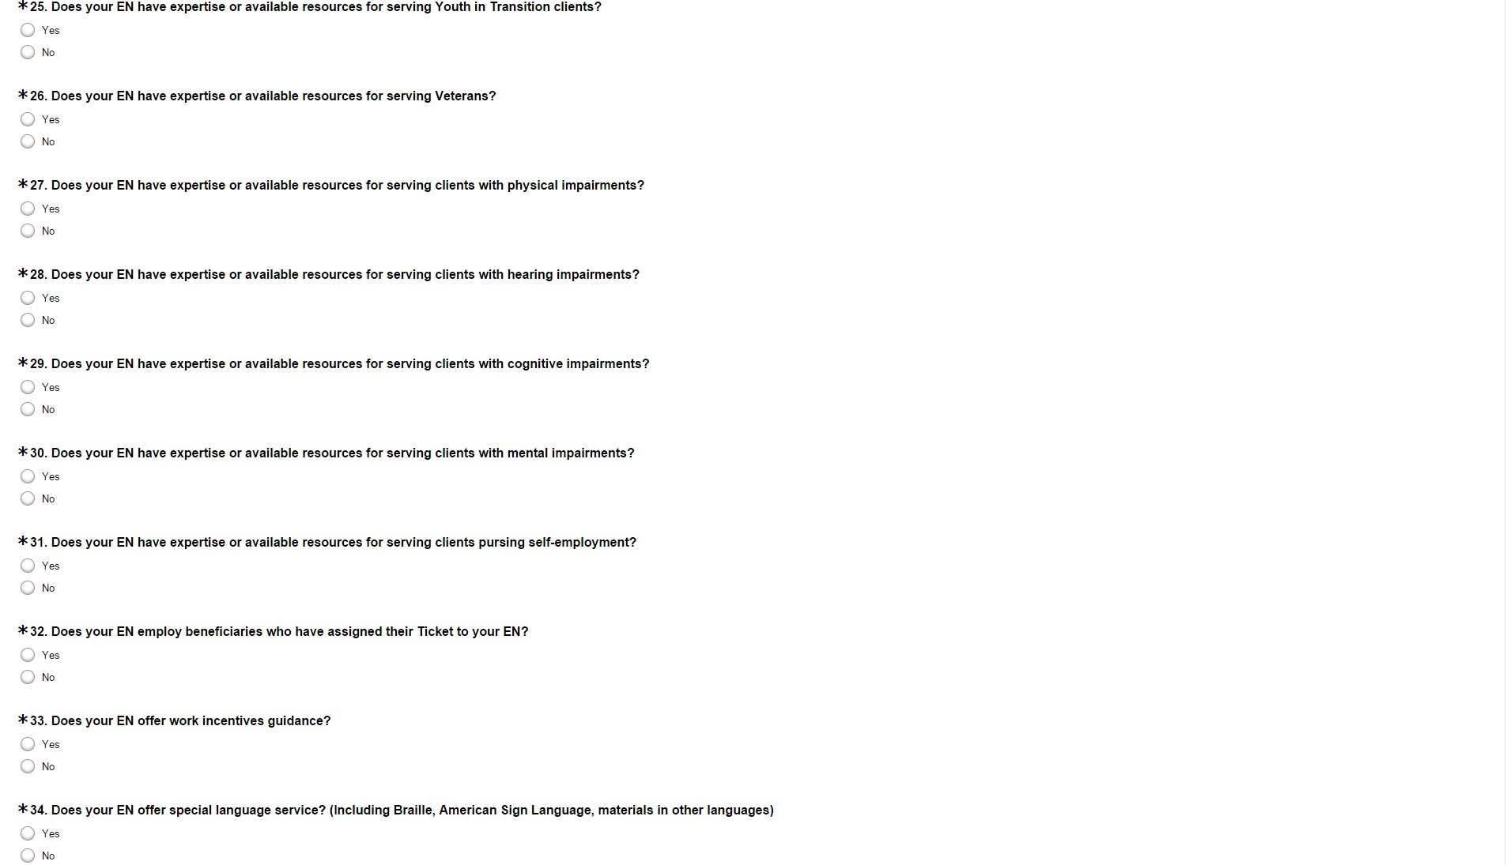
EN Service-Related Questions
Notes:
There are 10 EN Service-Related Questions. These questions seek information regarding services provided by the EN to the beneficiaries at all EN locations.

Slide 13
Completing the Survey
Notes:
After answering question 34, click the ‘Done’ button to submit the survey to the OSM. Remember, this needs to be completed by February 27^{h} to remain in compliance.

Slide 14
APOR Resources Online
Visit the APOR page in the Information Center to access:
APOR questions in a Word document
Frequently Asked Questions (FAQ)
APOR Terms and Definitions
https://yourtickettowork-uat.maximus.com/web/ttw/apor
Notes:
The OSM offers many resources to aid you in completing the APOR. Visit the APOR page in the Information Center to access:
APOR questions
FAQs
Terms and Definitions

Slide 15
Notes:
Now we will open the lines for any questions you may have.

