Slide 1
Effective Practices Webinar Series
Effective Practices with Virginia Department on Aging and Rehabilitative Services & Employment Networks
Operations Support Manager
Social Security’s Ticket to Work Program
August 12, 2014

Slide 2
Presenters
Facilitator: Gregory Bell, MBA, Senior Account Manager, Operations Support Manager (OSM)
David Leon, Ticket to Work Coordinator Grants & special Programs, Virginia Department on Aging and Rehabilitative Services (DARS)
Amy Wallish, MBA,CWIC, CEO, WIPA, Certified Benefits Counselor, Full Circle Employment Solutions
Lauren Parker, WISA, CWIC, Ticket to Work Program Director, The SkillSource Group
Sherman Gifford, M.S.,WISA, Vice President, The Choice Group
Joseph Ashley, Rh.D, CRC, Assistant Commissioner Grants & Special Programs, Virginia Department on Aging and Rehabilitative Services

Slide 3
Objectives
Share current statistics on Partnership Plus Handoffs
Discuss Virginia’s Partnership Plus Agreement
Discuss the effective practices and collaborative efforts of Employment Networks and Virginia DARS

Slide 4
Virginia Statistics
Eligible Ticket Holders 307,910
In use with VR 5,328
Assigned to ENs 893
ENs in Virginia 26
Percentage of ENs who are VR vendors 76%
Percentage of ENs who are Workforce 30%
Number of traditional Partnership Plus Handoffs 178
Number of Expedited Ticket Handoffs 54

Slide 5
Virginia’s ENs
5

Slide 6

Virginia Department of Aging and Rehabilitation
David Leon
Ticket to Work Coordinator
Virginia DARS

Slide 7
Virginia’s Partnership Plus Model
Benchmark retention payments available to ENs
Expedited Ticket Handoff Process
WorkWORLD for the Web and WISA services

Slide 8
What Are Benchmark Retention Payments For EN’s
Job retention payments to Employment Networks from DARS are offered in addition to the milestone/outcome payments received from SSA. These were added to provide an incentive for Employment Networks to participate with DARS in the Partnership Plus model. These payments will be made to the Employment Network as clients reach important milestones in their continuing long term employment efforts. These retention payments reflect DARS’s commitment to support and to maintain meaningful long term work experiences for the client. They also offset the loss of Phase 1 payments to ENs.

Slide 9
WISA services
BPQY
WorkWORLD Analysis
IRWE/BWE
SEIE
PASS
Subsidy
Overpayment
1619(b)
Medicaid Works

Slide 10

Expedited Ticket Handoff
Nine Partnership Plus ENs have received handoffs
57 referrals made to ENs from Virginia DARS
41 of these referrals are now tickets assigned to Employment Networks

Slide 11
WorkWORLD for the Web
What it does:
Helps people find employment paths to higher net income through use of Federal & State work incentives & benefits
Individualized recommendations
Recognizes interaction of earnings, benefit programs, & work incentives
Has alerts to possible problems
Has a help section for Federal and State benefit information with Virginia Specific information.

Slide 12
Capacity building by the numbers
2009-10: 51 authorized services through 8 service providers
2010-11: 114 services 7 providers
2011-12: 330 services 17 providers
2012 -13: 818 services 27 providers (34 staff)
2013-14: YTD over 1,500 services 32 providers (48 staff)

Slide 13
Evidence of VR
Virginia has identified that counselors who utilize work incentives with their consumers have a 75% successful closure rate as compared to 41% for the same population when no work incentives are used.
This has remained consistent through the growth in authorizations.

Slide 14
Section 503
As a State VR agency, we are beginning to receive inquiries from federal contractors that need to expand their hiring rates of persons with disabilities to meet the 503 compliance regulations.
As job leads come in from these employers, they will be sent to all of our Partnership Plus ENs.
Virginia has quarterly Partnership Plus calls and other avenues to tap into this resource have been explored through this venue.

Slide 15

Full Circle Employment Solutions
Amy Wallish, MBA,CWIC,WIPA Chief Executive Officer

Slide 16
Full Circle Employment Solutions
About Full Circle:
EN since 2011
Multi-State EN
Specialty is work incentive and benefits counseling
5 fully certified Community Work Incentive Coordinators (CWIC) on staff
3 are trained as Work Incentive Advocate Specialist (WISA) in VA
Our strategy is all about PARTNERSHIP.

Slide 17
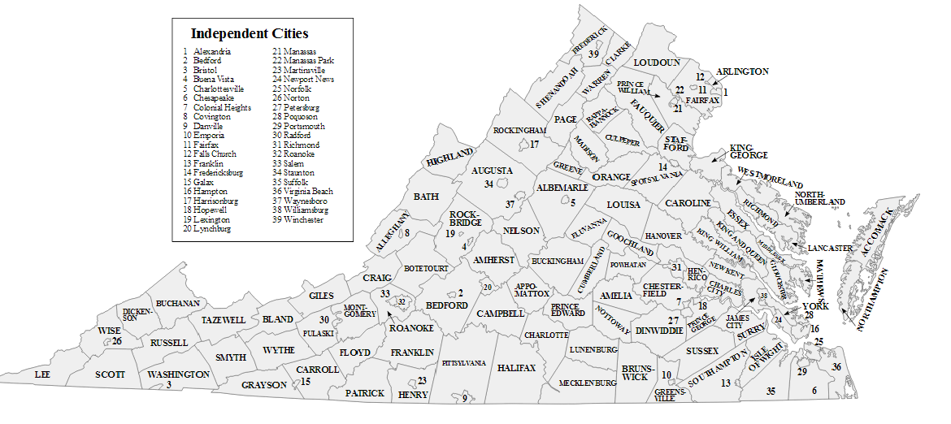
Virginia Service Area

Slide 18

Partnership is KEY!
Who:
Other ENs
Non-EN service providers
State Vocational Rehabilitation Agencies
Why:
Capacity building- quicker rate
Provide specialty supports through partners
Seamless transition from VR to EN

Slide 19
Full Circle’s EN Models
Administrative- EN on record; provide administrative support
Work Incentives- Provide administrative support to the agency and work incentives counseling to the agency’s beneficiaries
Mentor- Provide administrative support to an agency and technical assistance with all aspects of becoming an independent EN within a specific timeframe

Slide 20
Partnership with VR
Full Circle has formal and informal partnerships with VR in several states.
Expedited pilot in VA- handoffs before ticket closure
Service- serve more VR customers through partnerships with other providers in the state
Transition- seamless for the beneficiary from VR counselor to EN provider for long term support
Cost Reimbursement- Track months at SGA and report to VR so they can request
WIN-WIN-WIN

Slide 21
Partnership with VR cont.
Increase ticket assignments
  11 in 2011 to 130 as of 5/12/14
Identified cost reimbursement cases
  $537,996 in 2012-2013 - 22 people
  Additional $150,000 pending
Increase revenue to agencies
  Partner agency- $14896.80 (Jan-July)

Slide 22

The SkillSource Group Inc.
Lauren Parker, WISA, CWIC
Ticket to Work Program Director

Slide 23
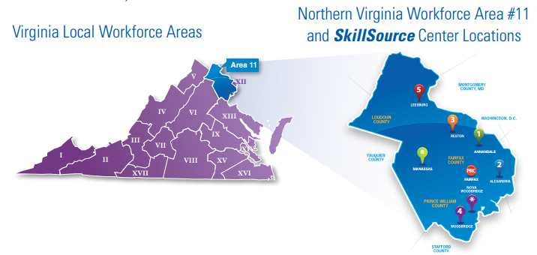
Service Area
77,431 Individual Job Seekers in 2013
Employment Network since 2010

Slide 24
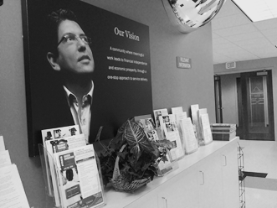
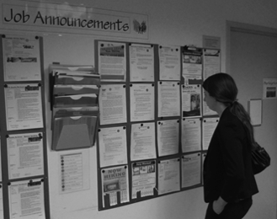

Program Model
WIA Services Integration
Work Incentives Counseling
Support After Employment
Expanding Services

Slide 25
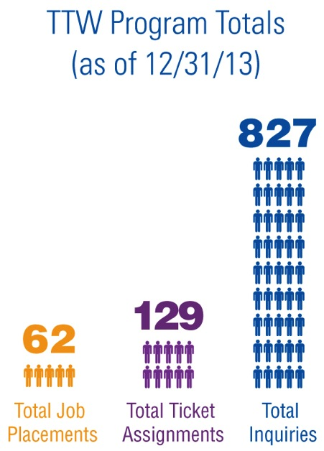
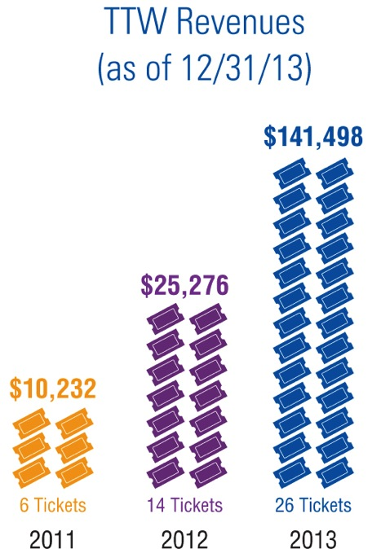
Performance

Slide 26

Effective Practices
Marketing Alignment
Disability Community
Growth Strategy
OneStop Presence

Slide 27

The Choice Group
Sherman Gifford, M.S., WISA
Vice President

Slide 28
The Choice Group
VR vendor since 1998
Employment Network since 2009
Over 50 job coaches serving clients throughout most of Virginia, with referrals from:
  Virginia Department for Aging and Rehabilitative Services
  Virginia Department for the Blind and Vision Impaired (DBVI)
  Virginia Department for Behavioral Health and Developmental Services (for Waiver services)

Slide 29

The Choice Group
To date 58 beneficiaries have been served through Ticket to Work.
Currently serving 25 Ticket Holders:
  13 are in Job Development (traditional Ticket to Work clients)
  12 are working
    8 are Partnership Plus (preparing to transition several more)
    4 are traditional TTW clients
    8 are part-time
    4 are full-time

Slide 30
The Choice Group
Collaborates with DARS to:
  Establish best practices for Work Incentive Specialist Advocate (WISA) services across the state
  Participate in pilot programs such as Partnership Plus and the Expedited Hand-Off programs
  Develop and improve WorkWORLD capabilities
  Identify VR clients who would be good candidates for TTW-PP
  Facilitate seamless transitions for TTW-PP clients
  Promote the benefits of the TTW-PP program to local VR Counselors regarding clients who are receiving services other than Supported Employment, such as Placement, Job Coach Training Services, and Self-Employment clients.

Slide 31
The Choice Group
Four Certified Work Incentives Specialists (WISAs) on staff - strategically located throughout the region
Often have the opportunity to discuss TTW-PP with VR clients while providing WISA services.
An early and ongoing service to TTW clients is:
  Access to individualized information about their benefits and work incentives
  The importance of reporting their income to Social Security
  Accessing the state-specific Medicaid buy-in program (Medicaid Works)

Slide 32
Choice Groups
Have modeled public-private collaboration by presenting with DARS at state and national conferences.
Open and encouraging to a variety of community partners about establishing Admin EN agreements.
Have financially incentivized job coaches to refer appropriate candidates for the Partnership Plus program.
Have referred Ticket to Work beneficiaries to VR, and facilitated their applications for service, when they make an informed decision they would be better served by VR.

Slide 33
Summary
You’ve learned about the Partnership Plus Expedited Ticket Handoff and how Virginia DARS and OSM are working with Partnership Plus ENs to increase handoffs through this process
Three Employment Networks have presented. Each has a different business model but all are independently successful as an EN and have established collaborative and sustaining partnerships with Virginia DARS.

Slide 34
Virginia Moving Forward
Joseph Ashley, Rh.D
Assistant Commissioner, Grants and Special Programs
Virginia DARS

Slide 35
Comments or Questions?
Gregory Bell, MBA
  Gregorydbell@maximus.com
  703.336.8069
David Leon
David.leon@dars.virginia.gov
804.662.7151

Slide 36
Presenters Contact Information
Amy Wallish, MBA, CWIC, WIPA
Amy.wallish@fullcircledc.com
240.478.8436,Toll Free: 888.466.2942 x1
Lauren Parker, WISA, CWIC
Lauren.parker@myskillsource.org
703 .752.1606
Sherman Gifford , M.S.,CRC,CRP,LPC
Sherman.gifford@thechoicegroup.com
804.278.9151 ext 121

