Slide 1

Blackboard Collaborate: Guest Access and Conferencing Features
Instructions for Participants | July 2016
Notes:
Welcome to this session on Blackboard Collaborate with a focus on how to access live web events on Collaborate as a guest user as well as an overview of conferencing features.

Slide 2
Presenters
Sabrina Berntsen
Ticket to Work
Adelle Barr
Ticket to Work

Slide 3
Overview
Introduction
Guest Access
Collaborate Features
Notes:
In this session we will give a brief introduction to Blackboard Collaborate, followed by the three main steps to access a session on Collaborate as a guest, and then end with the main participant features available on Collaborate.

Slide 4



Introduction
Notes:
To start - What is Blackboard Collaborate? Blackboard Collaborate is a web conferencing platform within Blackboard’s learning management system. It allows people from many different locations to participate in live events online. Ticket to Work is transitioning to use Collaborate for all its future live online sessions including but not limited to All Call sessions and EN Payments sessions. Currently there are no plans to use this platform for the WISE Events. We are here to help with that transition by giving you a basic tutorial on how to access and participate in these sessions hosted on Collaborate.
To note, in the future - your organization’s Signatory Authority chooses who in your organization is the Blackboard account holder. If you are a Blackboard account holder, you will have access to Collaborate using an email and password to the full Blackboard LMS. If you do not have Blackboard account access but would still like to join for conferencing sessions, you can access as a guest. Look out for more information regarding this in the future. The guest access process is what we will be focusing on for this presentation.

Slide 5
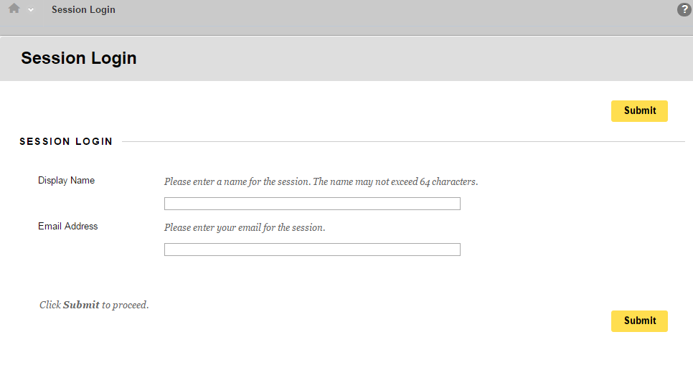
Guest Access
1. Receive URL
2.
Jane Smith – Employment Network of Baltimore
janesmith@employmentnetworkofbaltimore.com
Notes:
For guest access to live web conferencing events, Ticket to Work will send a specific URL beforehand. Once at the URL, guest users will see the session login page, as seen in this image. In the Display Name field, please enter your full name and your organization’s name; the name of your EN or VR. For example: Jane Smith – Employment Network of Baltimore, janesmith@employmentnetworkofbaltimore.com. This will help more easily distinguish participants during the session. Your email address does not need to correspond to the email where the URL was sent.

Slide 6
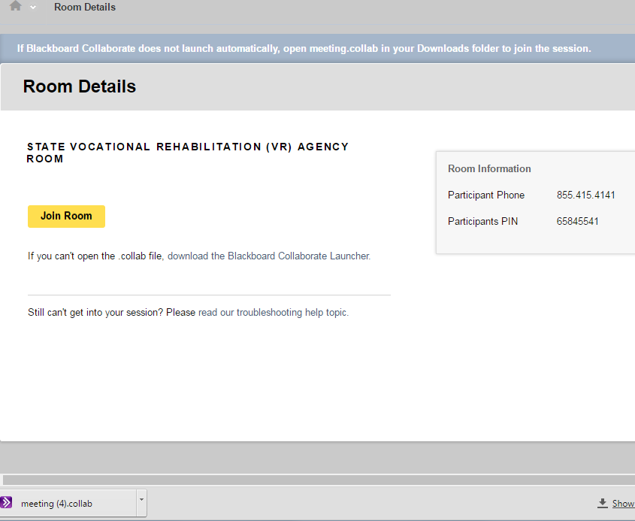
Guest Access
Notes:
After entering your name and email, you will reach the Room Details page, as seen in this image. The Room Details page will show you 1) the participant phone number and PIN. The participant phone number is used for the audio portion of the conferencing event. If you want to listen to any commentary, you will need the phone information. The second important piece is the Join Room button. Upon clicking the Join Room button, you should either be taken directly to the room or be asked to download the Blackboard Collaborate Launcher.
We will send out the detailed steps to download the launcher for those of you who may need to work with your IT departments.

Slide 7
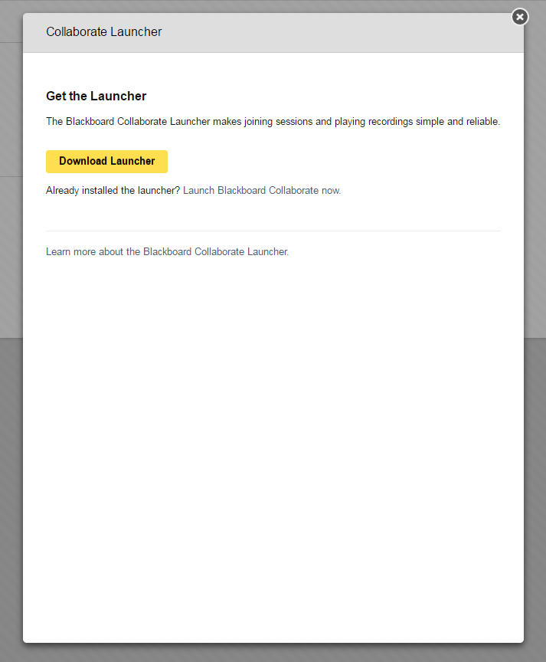
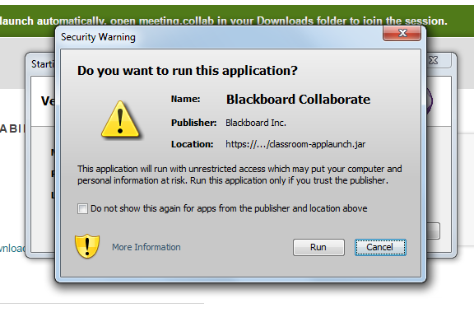
Guest Access
1
2
3
Notes:
If you are a first time user, a pop up may appear similar to image number 1 where it will ask if you have the Blackboard Collaborate Launcher. You can then click on the Download Launcher button and it will show your download at the bottom of your computer’s screen, as seen in picture 2. In some cases, after downloading the Collaborate Launcher, your computer will ask you for permission to run the application. Click Run to start the Collaborate session.

Slide 8
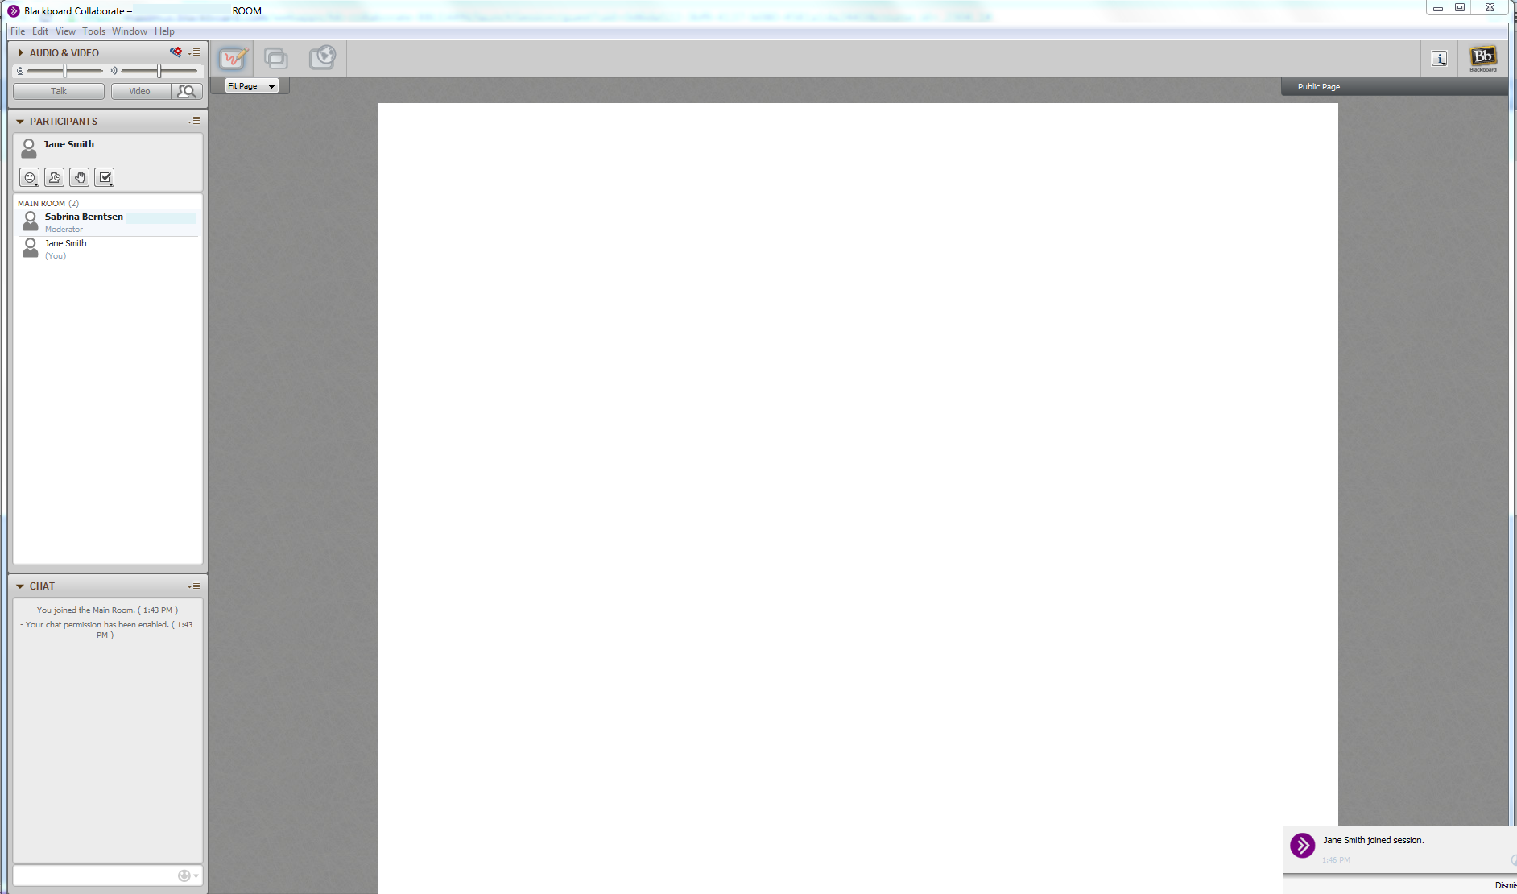

Collaborate Features
Notes:
All Collaborate sessions will have the same overall setup as seen in the image here. On the bottom right side of the screen you can see in real time when participants join or leave a session. On the top left hand side, there is a Participants box, as highlighted here. All participants’ display names who are currently logged onto the session will be viewable. This includes the moderator of the session. On the bottom left of the screen is the chat box.

Slide 9
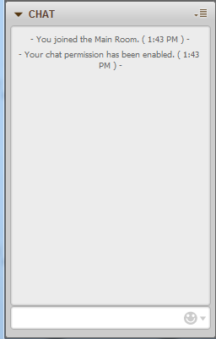
Collaborate Features: Chat
Notes:
Here is an enlarged image of the chat box. At the bottom of the chat box, you can type questions or comments. The text will appear for all participants to see.

Slide 10
Collaborate Features: Whiteboard
Notes:
In the middle of the screen is what is called the whiteboard. The whiteboard is the content area to view presentations and other content (for example, if the moderator decides to share his or her screen). Most of the time, only the moderator will have access to change what participants can see on the whiteboard.

Slide 11
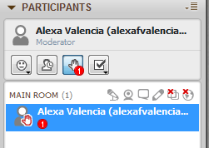
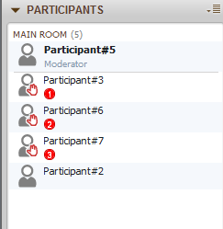
Collaborate Features: Raise Hand
Raise Hand: participants with a raised hand appear first in the participant list.
Notes:
On the participants box there are a few more features, including the raise hand feature, used, for example, if you would like to ask or answer a question. On the top of the participants box, the raise hand feature is the button with the hand icon. It is a visual signal for the moderator to see who is responding. If you click the raise hand feature, a hand icon will appear by your display name. If there is more than one participant using the raise hand feature, the hand icon will show along with a number. The number corresponds to who clicked the raise hand feature first.
It is important to note that the raise hand feature is not connected to the audio portion of the conference. If you wish to ask a question via audio, the instructions are the same as with previous conference calls - you will still need to enter Star [*] 1 on your keypad.

Slide 12
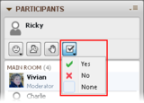
Collaborate Features: Polling
Notes:
The polling feature allows users to answer yes, no, or if made available, multiple choice questions from the facilitators. This button is located at the top of the Participants box with a checkmark icon.

Slide 13
Thank you!
Sabrina Berntsen
sabrinaberntsen@maximus.com
Adelle Barr
adellebarr@maximus.com

